Slide 1
Welcome to What is new in Azure Synapse Analytics

Slide 2
Agenda
Morning
Afternoon
8:00-8:30 | Welcome and what’s new overview
8:30-9:00 | GiHub integration and Azure DevOps for CI/CD
9:00-9:15 | Azure Machine Learning integration
9:15-9:30 | Lab environment overview
9:30-9:45 | Short Break
9:45-10:45 | Lab 01: Machine Learning integration
10:45-11:00 | Azure Data Explorer integration
11:00-11:15 | Spark Updates
11:15-12:15 | Lab 02: Spark
12:15-12:45 | Long Break
12:45-1:00 | CDM
1:00-1:15 | Purview
1:15-2:15 | Lab 03: CDM
2:15-2:30 | Short Break
2:30-2:45 | Monitoring enhancements
2:45-3:00 | Migrating existing data warehouses
3:00-3:15 | Migrating ADF assets
3:15-3:45 | Lab 04: Migrating data factory assets
3:45-4:00 | Conclusion
Presentation
Lab
Break
Notes:
Add the all day mentimeter QR code here as well.
Will remain in the main channel all day
Use the “Need help ask here” channel for problems with the labs
Use the chat for questions, coaches are here to assist

Slide 3
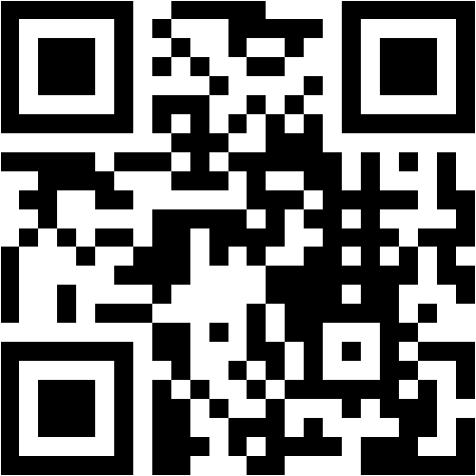
Mentimeter Poll
Scan QR Code
or Go to www.menti.com and use code
9044 6679
Notes:
Questions:
Did you attend the Azure Synapse Analytics Bootcamp training last year (yes/no)
What is your job role – CSA, GBB, ….
Have you been hands-on with Azure Synapse Analytics? (yes/no/a little)
How confident are you in your Azure Synapse Analytics technical level ? (rating 1-5, 1 being not confident, 5 being very confident)
What do you hope to learn in this session? (word cloud)

Slide 4
What’s new in Azure Synapse Analytics overview
Notes:
New connectors, items like snowflake
Snapshot data sharing – Azure Data Share

Slide 5
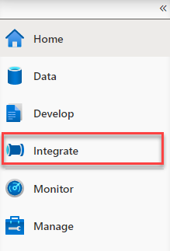
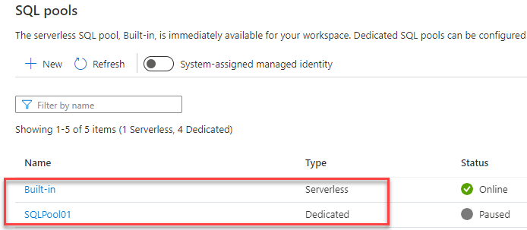
Synapse Studio Features - Naming
Orchestrate is now Integrate
Serverless pool renamed to “Built-in”
SQL pool rebranding: serverless and dedicated
Apache Spark in Azure Synapse Analytics
Notes:
Orchestrate is now Integrate, Datasets are now Integration datasets
Re-branded SQL pool types: serverless and dedicated, SQL on-demand is now called Built-in [used to be on-demand and provisioned]
Apache Spark in Azure Synapse Analytics (naming) – we do not call this ‘synapse spark’

Slide 6
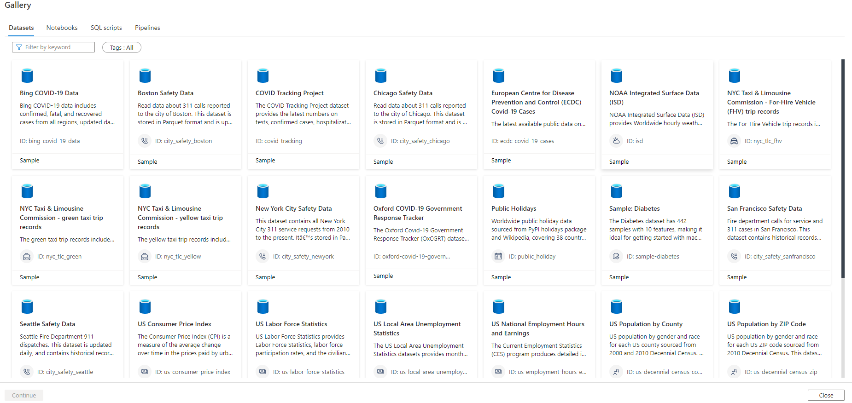
Synapse Studio Features – Knowledge Center
Notes:
Knowledge Center
Azure Open Datasets that can be used for practice, or augment existing data
Notebooks that demonstrate charting capabilities, creating managed and unmanaged Spark tables, and how to use Delta Lake.
Sample SQL scripts for common operations like applying JSON functions, granting users access to the serverless SQL pool database, and querying memory usage in a dedicated SQL pool.
Sample Pipelines that demonstrate various data movement operations from various sources, including incremental copy from SAP, copying data from a REST endpoint using Oauth, and Parquet CRUD operations.

Slide 7


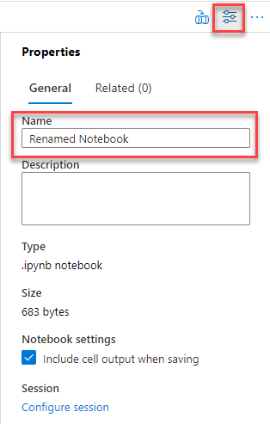
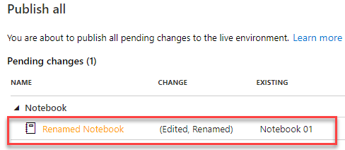
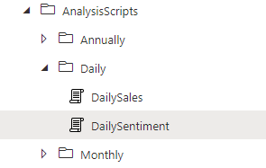
Synapse Studio Features – File organization
Organize and group files into folders
Rename Synapse artifacts
Notes:
Organize and group files in folders
Support for renaming items

Slide 8
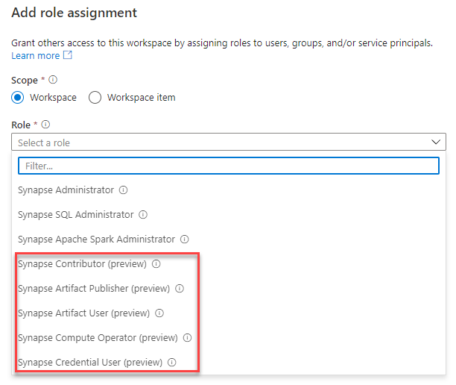
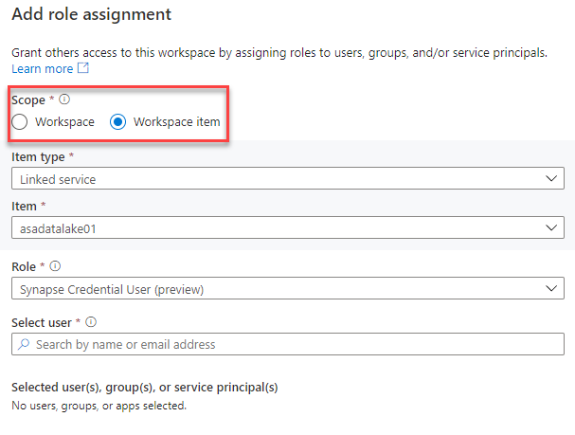
Synapse Studio Features - Security
Expanded roles (preview)
Scoped role assignment (preview)
Notes:
New roles in preview

Slide 9
Synapse Studio Features – Security (cont.)
Action | Synapse Administrator | Synapse Contributor | Synapse Artifact Author | Synapse Artifact Reader | Synapse Compute Manager | Synapse Credential User | Synapse Managed Private Endpoint Administrator | Synapse Reader
workspaces/read | Yes | Yes | Yes | Yes | Yes | Yes | Yes | Yes
workspaces/roleAssignments/write, delete | Yes
workspaces/managedPrivateEndpoint/write, delete | Yes |  |  |  |  |  | Yes
workspaces/bigDataPools/useCompute/action | Yes | Yes |  |  | Yes
workspaces/bigDataPools/viewLogs/action | Yes | Yes |  |  | Yes
workspaces/integrationRuntimes/useCompute/action | Yes | Yes |  |  | Yes
workspaces/integrationRuntimes/viewLogs/action | Yes | Yes |  |  | Yes
workspaces/artifacts/read | Yes | Yes | Yes | Yes
workspaces/notebooks/write, delete | Yes | Yes | Yes
workspaces/sparkJobDefinitions/write, delete | Yes | Yes | Yes
workspaces/sqlScripts/write, delete | Yes | Yes | Yes
workspaces/dataFlows/write, delete | Yes | Yes | Yes
workspaces/pipelines/write, delete | Yes | Yes | Yes
workspaces/triggers/write, delete | Yes | Yes | Yes
workspaces/datasets/write, delete | Yes | Yes | Yes
workspaces/libraries/write, delete | Yes | Yes | Yes
workspaces/linkedServices/write, delete | Yes | Yes | Yes
workspaces/credentials/write, delete | Yes | Yes | Yes
workspaces/notebooks/viewOutputs/action | Yes | Yes
workspaces/pipelines/viewOutputs/action | Yes | Yes
workspaces/linkedServices/useSecret/action | Yes |  |  |  |  | Yes
workspaces/credentials/useSecret/action | Yes |  |  |  |  | Yes
Notes:
Synapse RBAC roles - Azure Synapse Analytics | Microsoft Docs
https://docs.microsoft.com/en-us/azure/synapse-analytics/security/synapse-workspace-synapse-rbac-roles

Slide 10
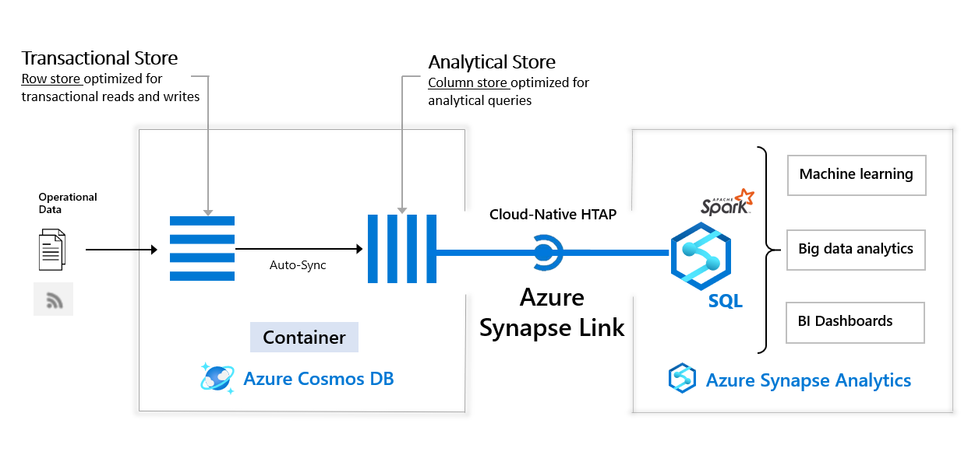
Azure Synapse Link for Cosmos DB
Low latency, non-impactful queries
Support for the SQL API and the API for Mongo DB
Multi-region support
Integrates with serverless SQL Pool and Apache Spark
Notes:
Azure Synapse Link for Cosmos DB (https://docs.microsoft.com/en-us/azure/cosmos-db/synapse-link)
Analyze large operational datasets without impacting transactional workloads
Historically, these datasets were extracted using ETL workloads, resulting in data movement and operational complexity.
Azure Synapse Link for Cosmos DB provides a cloud-native hybrid transactional and analytical processing (HTAP) capability that enables you to run near real-time analytics over operational data in Azure Cosmos DB.
The SQL API and API for MongoDB are supported
There is support for multi-region accounts, the analytical store will also be globally distributed (regardless of single write region or multiple write regions). The analytical queries can be served from the closest local region.
The analytical store can be queried by Apache Spark in Synapse Analytics (Scala, Python, SparkSQL, and C#) and the serverless SQL pool (T-SQL) [currently no support to access from a dedicated SQL pool]
The analytical store is read-only, however, you can still write to transactional containers
Latency between the transactional store to the analytical store is within 2-5 minutes
There is limitation that containers with analytical store turned on are not supported for automatic backup and restore at this time. The “transactional” piece is still backed up, but when restored it will be restored only as a transactional store with no analytical store provisioned.
There is a limitation that only the first 1000 properties, and the first 127 nested levels from the transactional schema are made available in the Analytical Store
Properties with spaces are also not supported in the analytical store
Analytical Schema Constraints -> https://docs.microsoft.com/en-us/azure/cosmos-db/analytical-store-introduction#schema-constraints

Slide 11
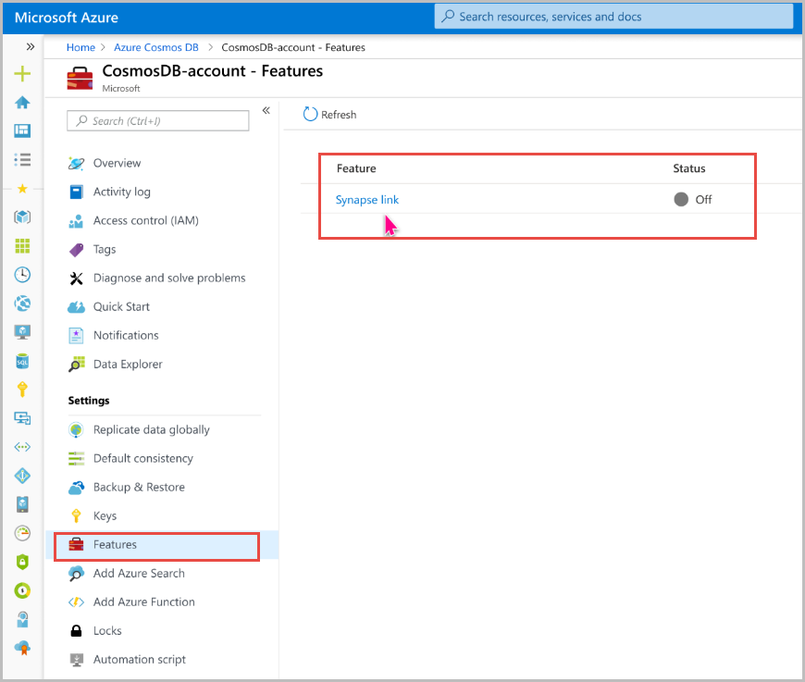
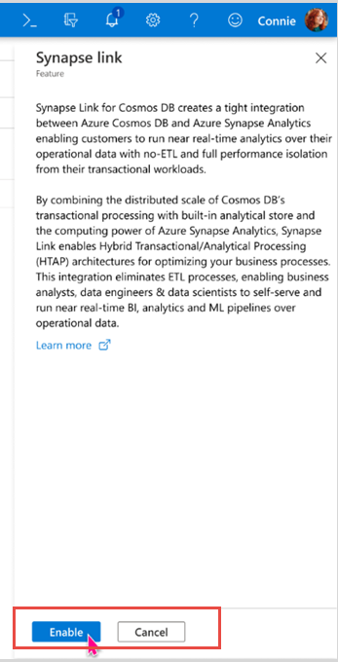
Enable Azure Synapse Link for Cosmos DB
Notes:
- To enable Azure Synapse Link for Cosmos DB, access the Cosmos DB resource
Select Features from the left menu, and select Synapse link.
In the Synapse Link blade, select Enable. It can take a few minutes for this feature to be enabled.
Once enabled, there isn’t a way to disable it
There is support for managed private endpoint between Azure Synapse and Cosmos DB

Slide 12
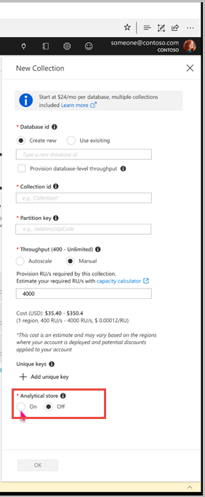
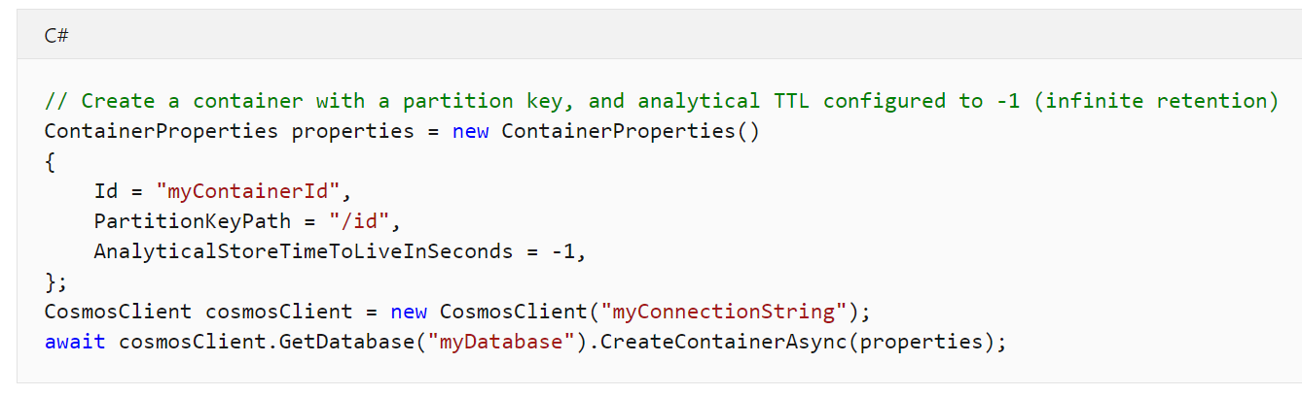
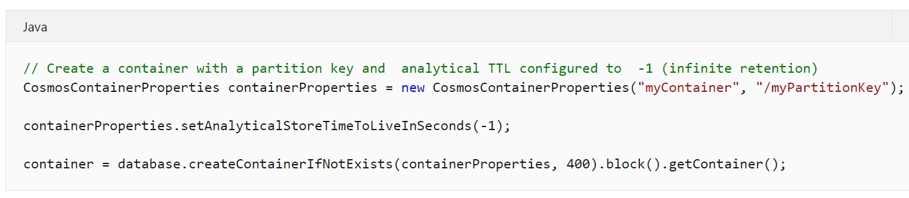


Create a container with analytical store
Also with Python, Azure CLI, Powershell…
Analytical Store Container
Transactional Store Container
Notes:
- currently only supported on NEW containers only
Ensure you select “ON” for the Analytical store field
This will create a container with the AnalyticalTTL property set to the default value of -1, meaning infinite retention
You can change the AnalyticalTTL using the Cosmos DB Data Explorer, selecting the container -> Scale & Settings, under Settings you will find the Analytical Storage Time to Live
The analytical store retains all the historical versions of records
Create containers with analytical store in the Data Explorer for Cosmos DB in the Azure Portal or through various SDKs and APIs.
If a container has been created with analytical store, this feature cannot be disabled

Slide 13
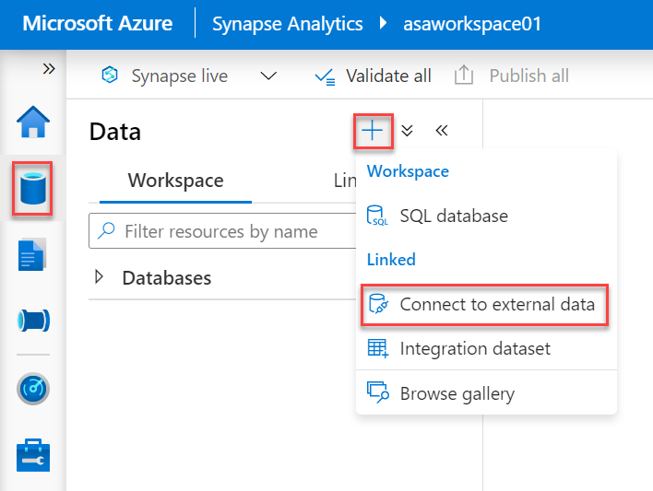
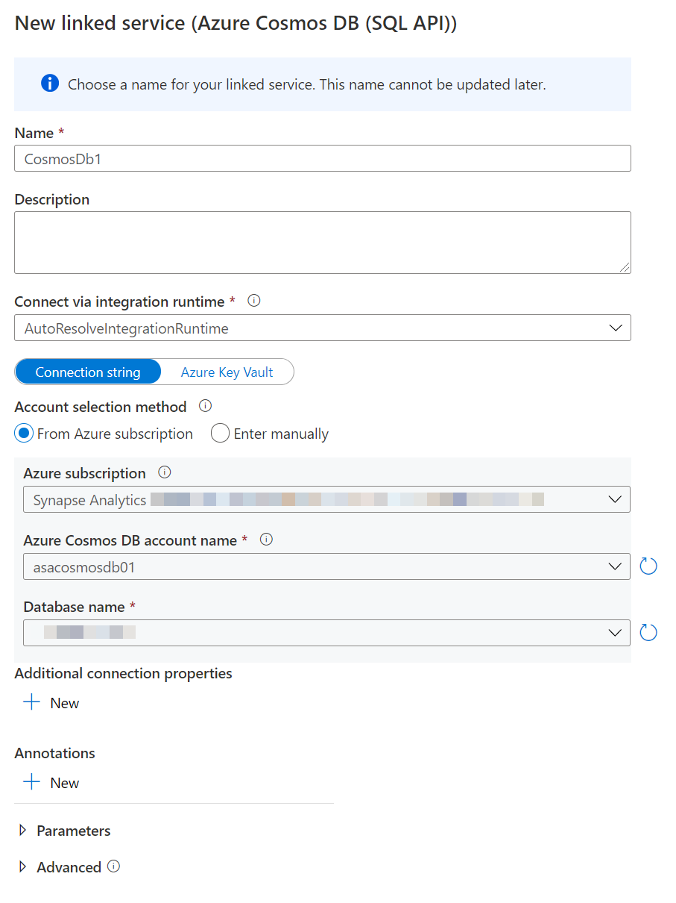
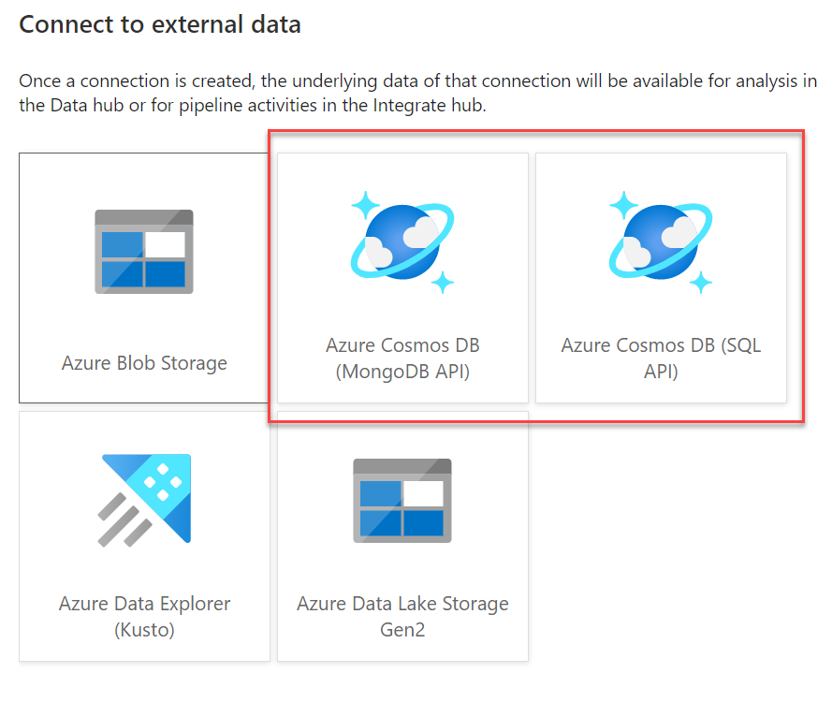
Create a Cosmos DB Linked Service
Notes:
2 ways, create a linked service through the Manage Hub OR through the Data Hub and Selecting to connect to external data.

Slide 14
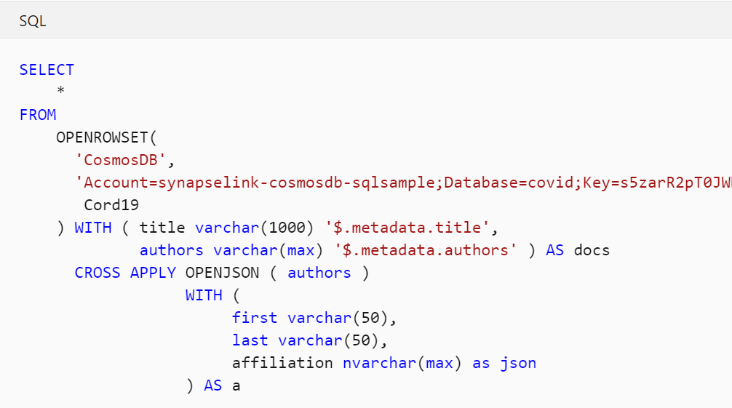
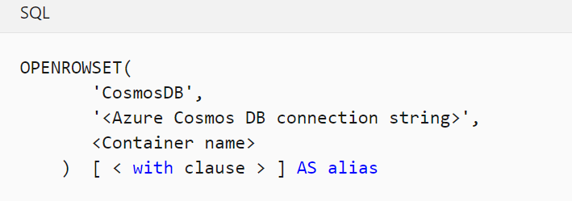
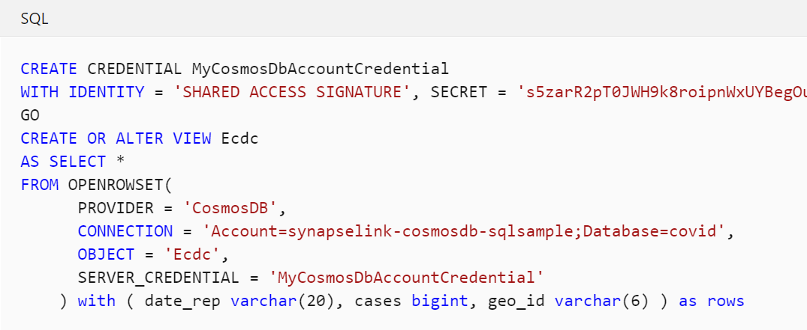
Query analytical Cosmos DB data from a serverless SQL pool
alter database current collate Latin1_General_100_CI_AI_SC_UTF8
Notes:
If no schema is supplied, the serverless SQL pool will use automatic schema inference. It is strongly encouraged to explicitly define the schema as there is impacts to performance.
Ability to use JSON functionality found in T-SQL, such as OPENJSON to flatten JSON structures
Create a user database for containing views
Prepare views on top of Cosmos DB data it is recommended to create a separate credential containing the DB Account key and use this to access the data via OPENROWSET. DO NOT STORE THE ACCOUNT KEY IN THE VIEW DEFINITION !!!
Be sure to enable UTF-8 database collation as string values are stored in the Azure Cosmos DB analytical store as UTF-8
If managed vnet is enabled for the workspace, because the serverless pools are multi-tenant (and not in the managed vnet), it will be blocked from accessing the account. To fix this use Network Isolation for the Cosmos DB account from a Synapse Workspace. (https://docs.microsoft.com/en-us/azure/cosmos-db/analytical-store-private-endpoints#using-synapse-serverless-sql-pools)

Slide 15
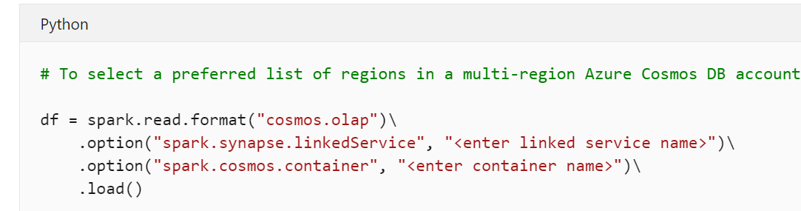
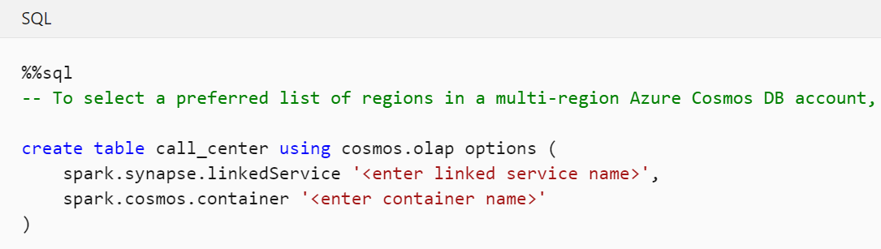
Query analytical Cosmos DB data from Spark
Notes:
Querying data from Apache Spark in Azure Synapse Analytics uses the linked service
Spark SQL tables can be used to query the analytical store directly
If the schema may change in the future, be sure to set the spark.cosmos.autoSchemaMerge option to true when creating the table
Preferred regions can be set in options as well .option(“spark.cosmos.preferredRegions”, ‘<Region1>, <Region2>’)
If you have managed Vnet enabled for the workspace, with Azure Spark for Azure Synapse Analytics, access is only allowed through a managed private endpoint. Maintenance for these private endpoints is found in the Manage Hub. Be sure to select the “Analytical” Target Sub-Resource (https://docs.microsoft.com/en-us/azure/cosmos-db/analytical-store-private-endpoints)

Slide 16
Serverless SQL pool enhancements
Cost control
Fully supported in SSMS 18.7
Fully supported in ADS 1.24.0
STRING_AGG, OFFSET/FETCH, Pivot/Unpivot, SESSION_CONTEXT and CONTEXT_INFO are now supported.
Automatic schema discovery on delimited text files with parser_version 2.0
Notes:
Cost control on serverless SQL – set limits for day/week/month
Full support for serverless SQL pools in SQL Server Management Studio (SSMS 18.7) and Azure Data Studio (ADS) 1.24.0
New T-SQL language features are available in serverless SQL pool. New features that you can use are: STRING_AGG, OFFSET/FETCH, Pivot/Unpivot, SESSION_CONTEXT, and CONTEXT_INFO
Automatic schema discovery on delimited text files (parser_version 2.0)

Slide 17
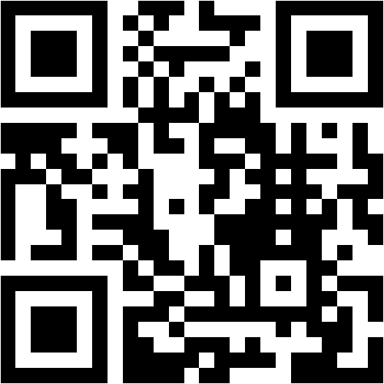
Mentimeter Poll
Scan QR Code
or Go to www.menti.com and use code
2104 4036
Notes:
Questions:
Did you attend the Azure Synapse Analytics Bootcamp training last year (yes/no)
What is your job role – CSA, GBB, ….
Have you been hands-on with Azure Synapse Analytics? (yes/no/a little)
How confident are you in your Azure Synapse Analytics technical level ? (rating 1-5, 1 being not confident, 5 being very confident)
What do you hope to learn in this session? (word cloud)

Slide 18

Deep dives for today
GitHub and DevOps
Azure Machine Learning
Azure Data Explorer integration
Spark Updates
Monitoring enhancements
Migration from existing data warehouses
Migration from Azure Data Factory

Slide 19
GitHub integration and Azure DevOps for CI/CD
Notes:
Integration with GitHub CI/CD

Slide 20
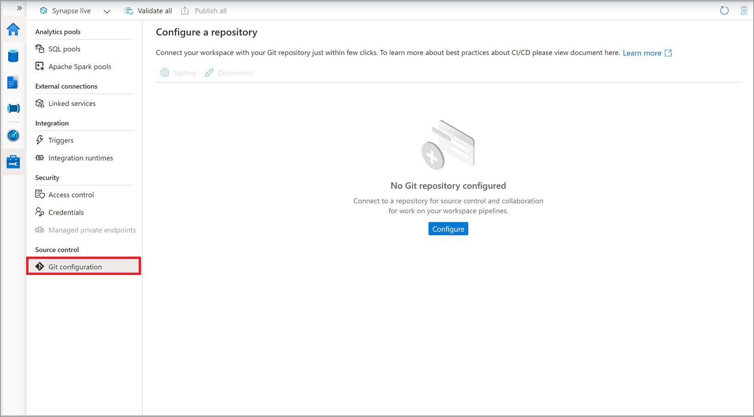
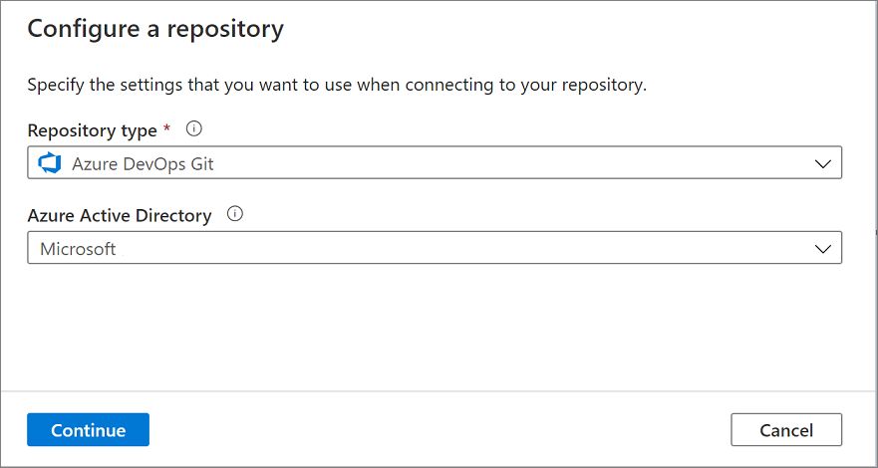
Source control in Azure Synapse Studio
Notes:
- Currently not available in the Azure Government Cloud
Workspace can only be configured with a single Git repository
Repository type is Azure DevOps Git or GitHub
If using GitHub, you must authorize Azure Synapse as an application
You must create an initialized repository to hold your source code ahead of time. They must not be empty, so add a readme when creating the repository so that it initializes the repository.

Slide 21
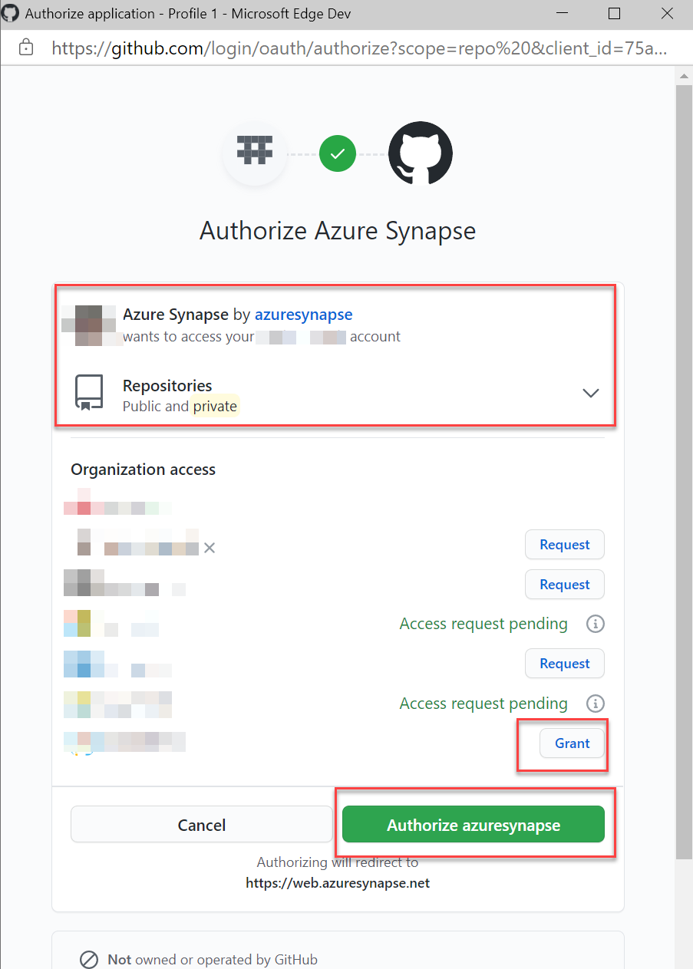
GitHub Authorization
Notes:
If using a GitHub repository and want Azure Synapse to be granted Oauth application privileges, be sure to grant organizational access when prompted.

Slide 22
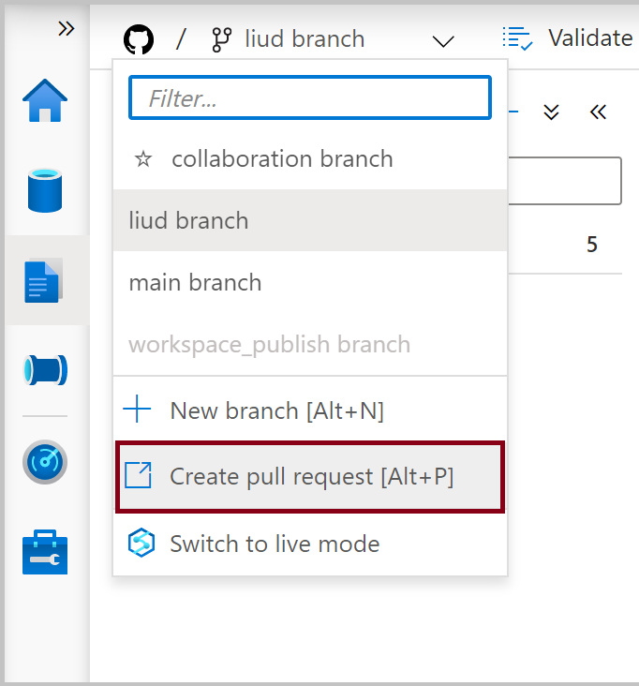
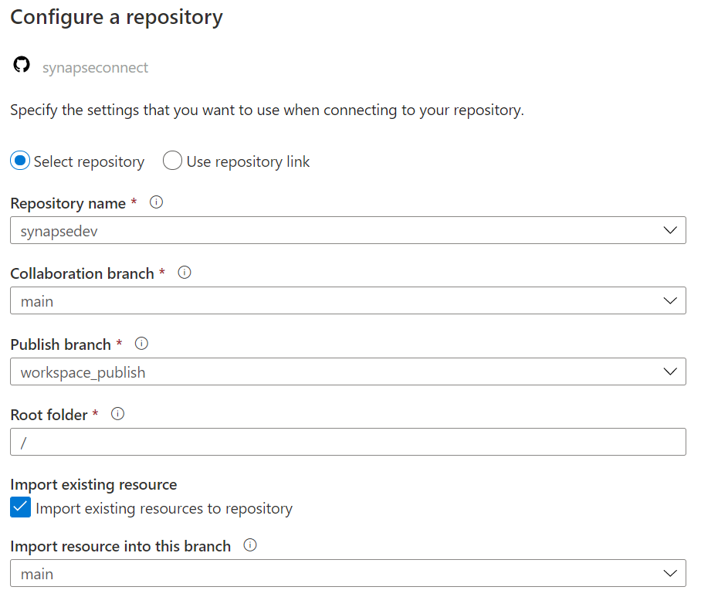
Git Branches
Notes:
When configuring the repository, if you granted permission to both public and private repositories, they will be listed here.
Select the desired repository.
NOTE: You are able to create new branches from within Synapse Studio. A good recommendation is to create features based on the main branch to implement changes or new artifacts.
The Collaboration branch is the branch where things will be committed while development is in-progress. This is typically the main branch of the repository. Most people should not be able to commit into this branch. They can issue Pull Requests from their own feature branches for inclusion.
The workspace_publish branch will be the end-destination. When the code in the main branch reaches a deployment ready state, ensure the collaboration (or main) branch is selected in the Synapse Workspace, and select “Publish” to move these new artifacts into the workspace_publish branch.
When artifacts are moved to the publish branch you can then create a CI/CD release pipeline to automate a push to a production workspace.

Slide 23
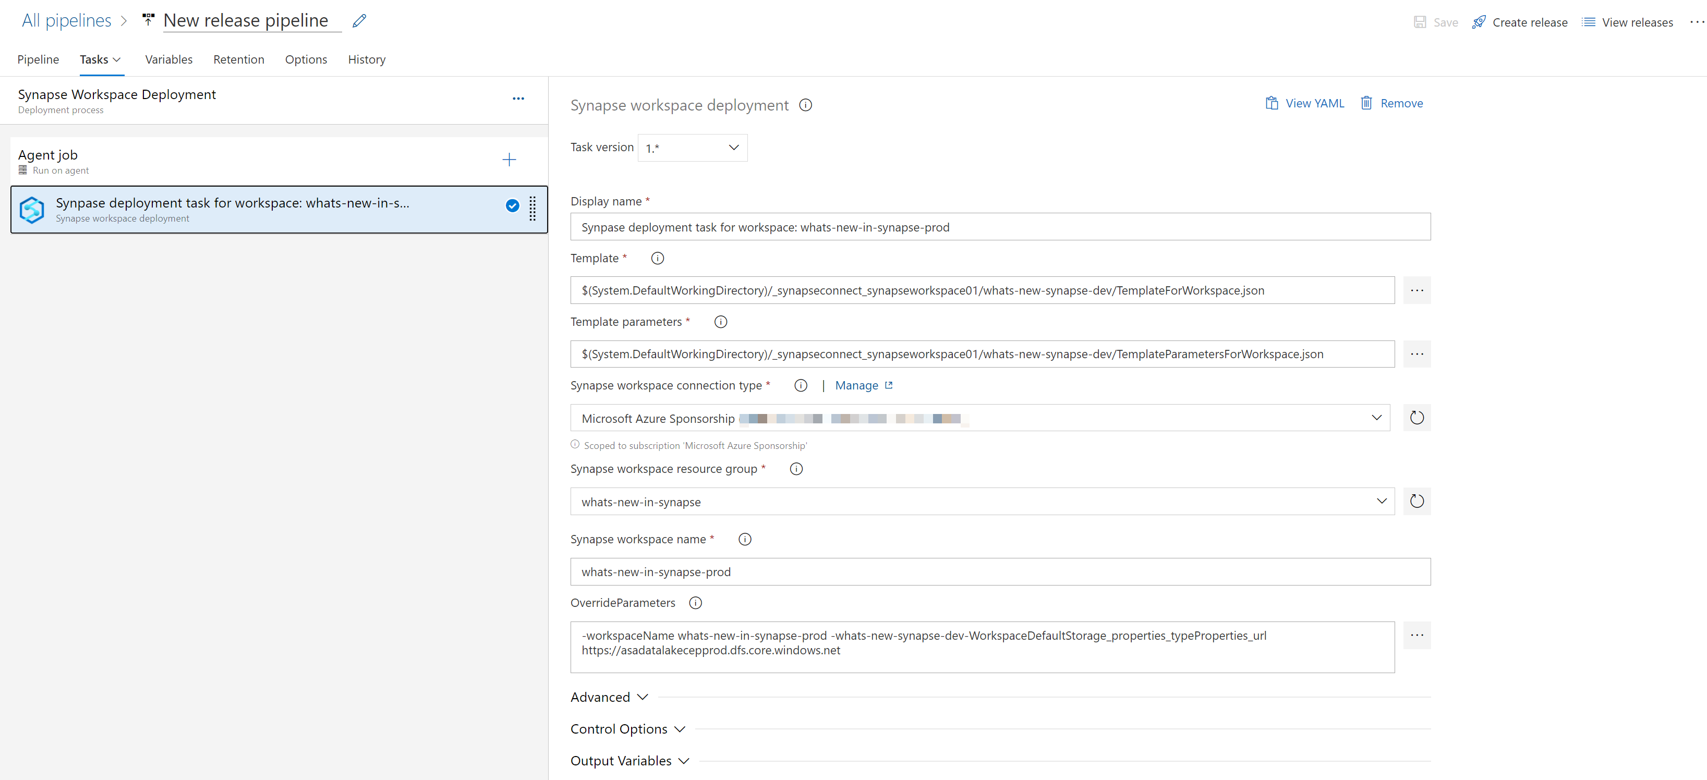
CI/CD with Azure DevOps
- Establish service connections required (GitHub, ARM, Azure)
- Marketplace extension called ‘Synapse workspace deployment’ to assist in deploying to a production workspace (and overriding template variable values)
Notes:
Continuous Integration (CI) is the process of automating the build and testing of code every time a team member commits changes to version control. Continuous Deployment (CD) is the process to build, test, configure, and deploy from multiple testing or staging environments to a production environment.
For Azure Synapse workspace, continuous integration and delivery (CI/CD) moves all entities from one environment (development, test, production) to another. To promote your workspace to another workspace, there are two parts: use ARM templates to create or update workspace resources (pools and workspace); migrate artifacts (SQL scripts, notebook, Spark job definition, pipelines, datasets, data flows, and so on) with Synapse CI/CD tools in Azure DevOps.
In this presentation, we’ll cover migrating artifacts using the tools in Azure DevOps.

Slide 24
Demo
Synapse source control and CI/CD
Notes:
GitHub CI/CD with Azure DevOps
Pre-requisites
2 Synapse workspaces deployed (dev prod)
1 Azure DevOps organization (so you can create projects) https://dev.azure.com/trilliuminnovations/
Previous cleanup: Remember to remove Azure Synapse as a trusted OAuth application (Settings)
Walkthrough Connecting to GitHub
1. Access GitHub, log in as synapseconnect
2. Create new repository called synapseworkspace01, initialize this with a Readme
3. Open Synapse Dev workspace
4. Select the Develop hub
5. Show the drop down for Synapse Live/setup source control
6. Open the Manage Hub
7. Select "Git configuration" below the Source Control heading
8. Select the "Configure" button
9. Repository Type: GitHub, GitHub account: synapseconnect
10. Log into GitHub using the appropriate credentials
11. Authorize Azure Synapse to public and private repositories (that's the only option)
12. Select the repository created in #2 (synapseworkspace01), collaboration branch: main, publish branch: workspace_publish, check to import existing, select to import existing into the main branch, select Apply
13. In GitHub, show the newly created resources
Walkthrough creating a new feature branch, creating an artifact, committing, and issuing a PR
1. In Synapse Studio, select the Develop Hub, expand the source control drop down and select new branch
2. In the Set working branch window, type in "feature/checkversion", then save
3. Create new SQL Script, name it "Check Version", populate it with "select @@version", run it on Built-in to show it works
4. Select Commit (or Commit all) button in the toolbar
5. In Synapse Studio, change the branch back to main, note that the new script is not there
6. In Synapse Studio, change the branch back to "feature/checkversion"
7. Return to GitHub, show that the Check Version.json artifact has been committed to the branch
8. Now we're ready to commit this to main. In Synapse Studio, create a Pull Request
9. Merge pull request
10. Show how the sqlscript is now in main.
11. Return to Synapse Studio, change the current branch back to main
12. Select the "Publish" button to create the templates and artifacts needed for a release into the workspace_publish branch
Walkthrough creating a release pipeline in Azure DevOps
1. In Azure DevOps (dev.azure.com), create a project "whats-new-in-synapse"
2. In the DevOps project, expand "Pipelines", select "Releases"
3. Select New pipeline
4. Start with "Empty job"
5. Name the stage "Synapse Workspace Deployment"
6. In the first box, select "Add an artifact"
7. Create service connection, and authorize (for synapseconnect)
8. Go back to the Add an Artifact blade, select the new connection and the repository (selecting the ...)
9. Select "workspace_publish" for default branch, Default version: Latest from default branch (leave the rest as defaults), press Add
10. In Azure DevOps, select the Shopping bag icon and access the marketplace (THIS IS THE ONLY WAY)
11. Search for "Synapse", choose Microsoft's "Synapse workspace deployment" -> "Get it free"
12. ALREADY INSTALLED - but you would install it to the organization
13. Select the job link in "Synapse Workspace Deployment" stage box
14. Select the + on the Agent job to add a task
15. search for Synapse workspace deployment, select "Add"
16. Select the newly added task, in Template, select the ... and navigate down the tree to find the "TemplateForWorkspace.json"
17. For the parameters template, navigate down the tree until you see "TemplateParamersForWorkspace.json"
18. Select the Sponsorship subscription, select Authorize (this will create an Azure service connection)
19. Hit refresh next to "Synapse workspace group"
20. set the name of the production workspace
21. Look at the template variables in Source Control
22. in the OverrideParameters - override workspaceName and Workspace Default storage (copy and paste)
23. Save in the default folder.
24. Select "Create release"
25. Open the production workspace, Manage, access control
26. Add "trillium ....." as a workspace admin (this is the Service Principal for DevOps)
27. Back in DevOps, select the release, and select "Deploy" in the stages
28. Refresh the portal window of prod
29. Access the Develop Hub, and show that "Check Version" is there.
30. Select the Pipeline, and select "Edit" in the top window
31. Select the lightning bolt on the GitHub artifact
32. Enable the Continuous deployment trigger, for Branch filters include only workspace_publish, SAVE
33. In the dev workspace, create a branch, new SQL script (GetDateTime with content "SELECT GETDATE () AS 'DateAndTime';", PR, merge, Change to main branch, PUBLISH
34. go back to DevOps and watch the CD

Slide 25
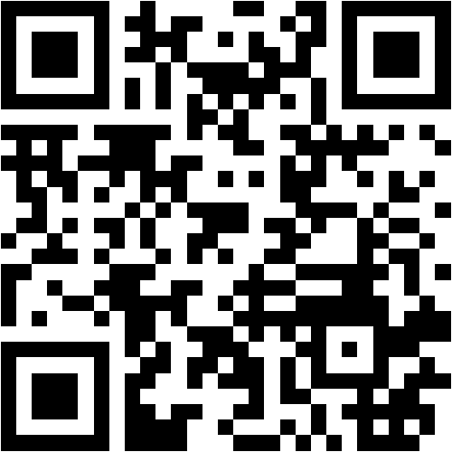
Mentimeter Poll
Scan QR Code
or Go to www.menti.com and use code
2492 0311
Notes:
Questions:
Did you attend the Azure Synapse Analytics Bootcamp training last year (yes/no)
What is your job role – CSA, GBB, ….
Have you been hands-on with Azure Synapse Analytics? (yes/no/a little)
How confident are you in your Azure Synapse Analytics technical level ? (rating 1-5, 1 being not confident, 5 being very confident)
What do you hope to learn in this session? (word cloud)

Slide 26
Azure Machine Learning integration
Notes:
Integration with Azure Machine learning / AutoML wizard / Machine Learning Scoring Wizard
Cognitive Services enrichment wizard

Slide 27
High level machine learning process
Business and data understanding
Data acquisition
Data preparation
Modeling
Model deployment and scoring
Notes:
The typical data science project has a certain number of repeatable processes.
It begins with business and data understanding. What problems are we looking to solve, and what types of data can help us solve that problem.
Data acquisition gathers the required data. Azure Synapse Analytics has powerful tools for data ingestion in the form of Synapse Pipelines.
When it comes to data preparation, leverage Synapse pipelines with features such as Data flows and notebooks. Data exploration and preparation in Synapse Analytics is quick with the use of tools like Apache Spark and serverless SQL pools; they can query data over raw files stored in the data lake. Further enhance data exploration with visualizations using several libraries available in Apache Spark and in the SQL query window by toggling to a fully customizable Chart view of the results.
Let’s take a moment now and dive deeper into the modeling and model deployment and scoring steps.

Slide 28
Modeling with Spark ML Algorithms
Classification and Regression | Linear Models (SVMs, logistic regression, linear regression) Naïve Bayes Decision Trees Ensembles of trees (Random Forest, Gradient-Boosted Trees) Isotonic regression
Clustering | k-means and streaming k-means Gaussian mixture Power iteration clustering (PIC) Latent Dirichlet allocation (LDA)
Collaborative Filtering | Alternating least squares (ALS)
Dimensionality Reduction | SVD PCA
Frequent Pattern Mining | FP-growth Association rules
Basic Statistics | Summary statistics Correlations Stratified sampling Hypothesis testing Random data generation
Spark ML Algorithms
Notes:
When it comes to Modeling, you have choices, you can begin with modeling directly in Apache Spark using tools like SparkMLlib or other popular libraries such as SciKit Learn. (SparkMLlib tutorial https://docs.microsoft.com/en-us/azure/synapse-analytics/spark/apache-spark-machine-learning-mllib-notebook).

Slide 29
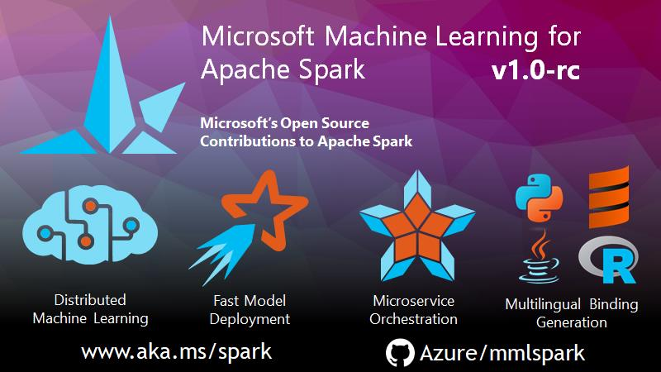
Notes:
MMLSpark is an ecosystem of tools aimed towards expanding the distributed computing framework Apache Spark in several new directions. MMLSpark adds many deep learning and data science tools to the Spark ecosystem, including seamless integration of Spark Machine Learning pipelines with Microsoft Cognitive Toolkit (CNTK), LightGBM and OpenCV. These tools enable powerful and highly-scalable predictive and analytical models for a variety of datasources.
MMLSpark also brings new networking capabilities to the Spark Ecosystem. With the HTTP on Spark project, users can embed any web service into their SparkML models. In this vein, MMLSpark provides easy to use SparkML transformers for a wide variety of Microsoft Cognitive Services. For production grade deployment, the Spark Serving project enables high throughput, sub-millisecond latency web services, backed by your Spark cluster.

Slide 30
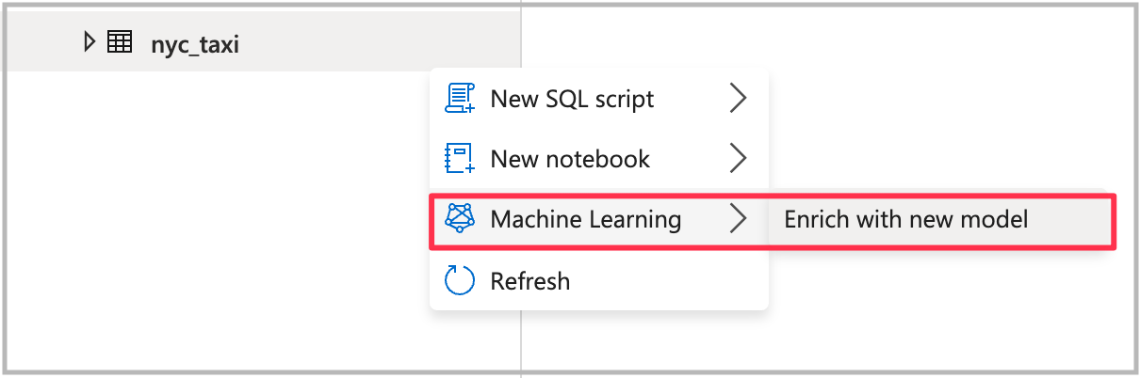
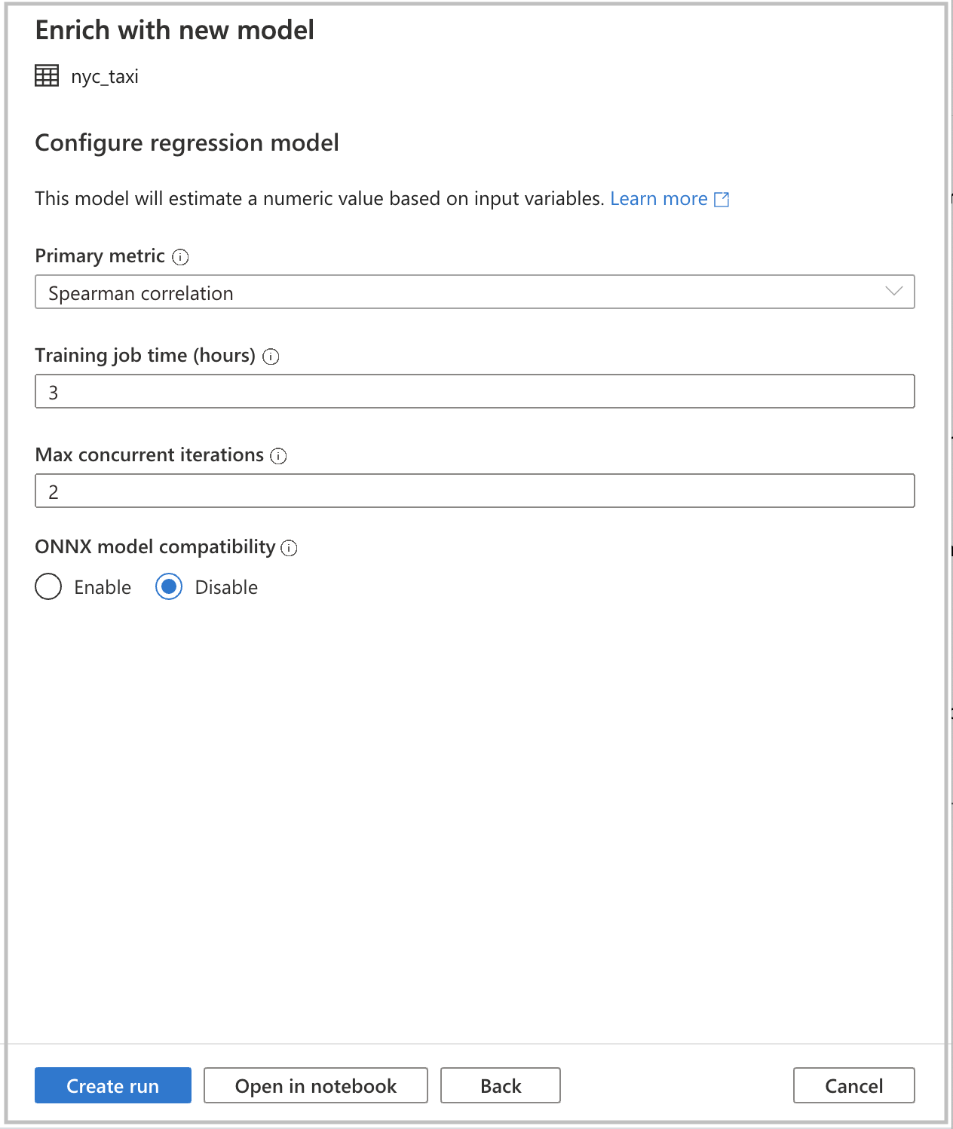


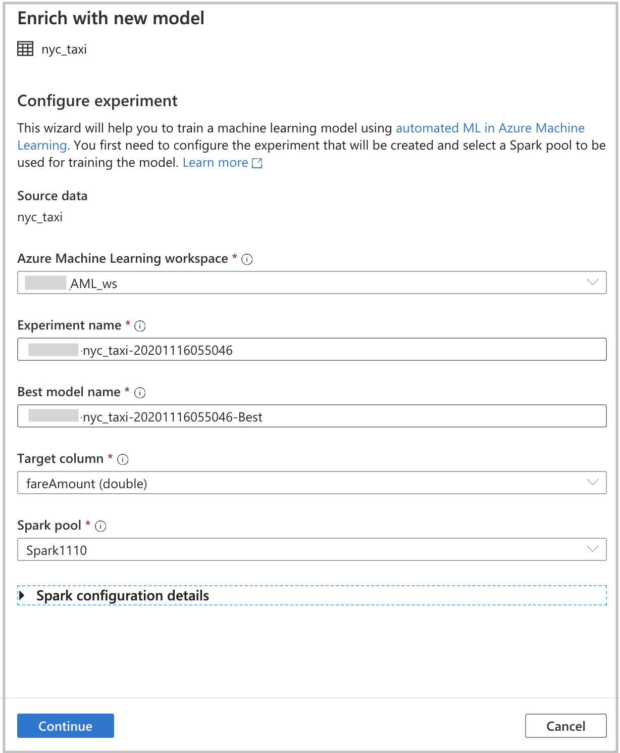
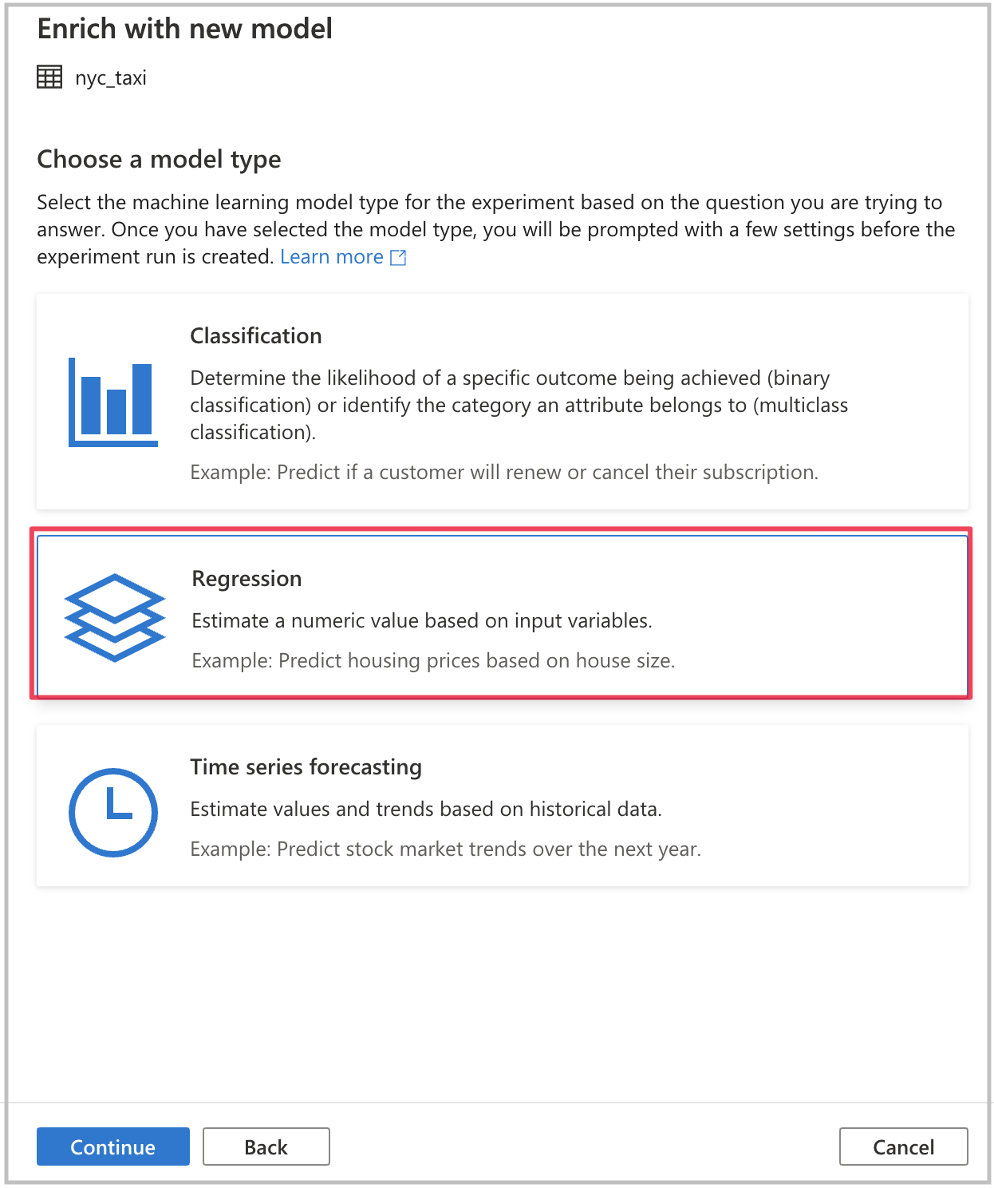
Modeling with Azure Machine Learning – Code Free
Notes:
Another way to train machine learning models, that does not require much prior familiarity with machine learning, is to use automated ML. Automated ML is a feature that automatically trains a set of machine learning models and allows the user to select the best model based on specific metrics.
Thanks to a seamless integration with Azure Machine Learning from Azure Synapse Notebooks, users can easily leverage automated ML in Synapse with passthrough Azure Active Directory authentication. This means that you only need to point to your Azure Machine Learning workspace and do not need to enter any credentials. (automated ML tutorial https://docs.microsoft.com/en-us/azure/synapse-analytics/spark/apache-spark-azure-machine-learning-tutorial)
Right-click on a Spark Table, select Enrich with new model.
After providing the settings and configuration of the experiment, you can select “Create run” in the UI to submit the experiment directly in Azure Machine Learning. If you would rather have it generate PySpark code instead, for a more code-centric approach, select the “Open in notebook” option.

Slide 31
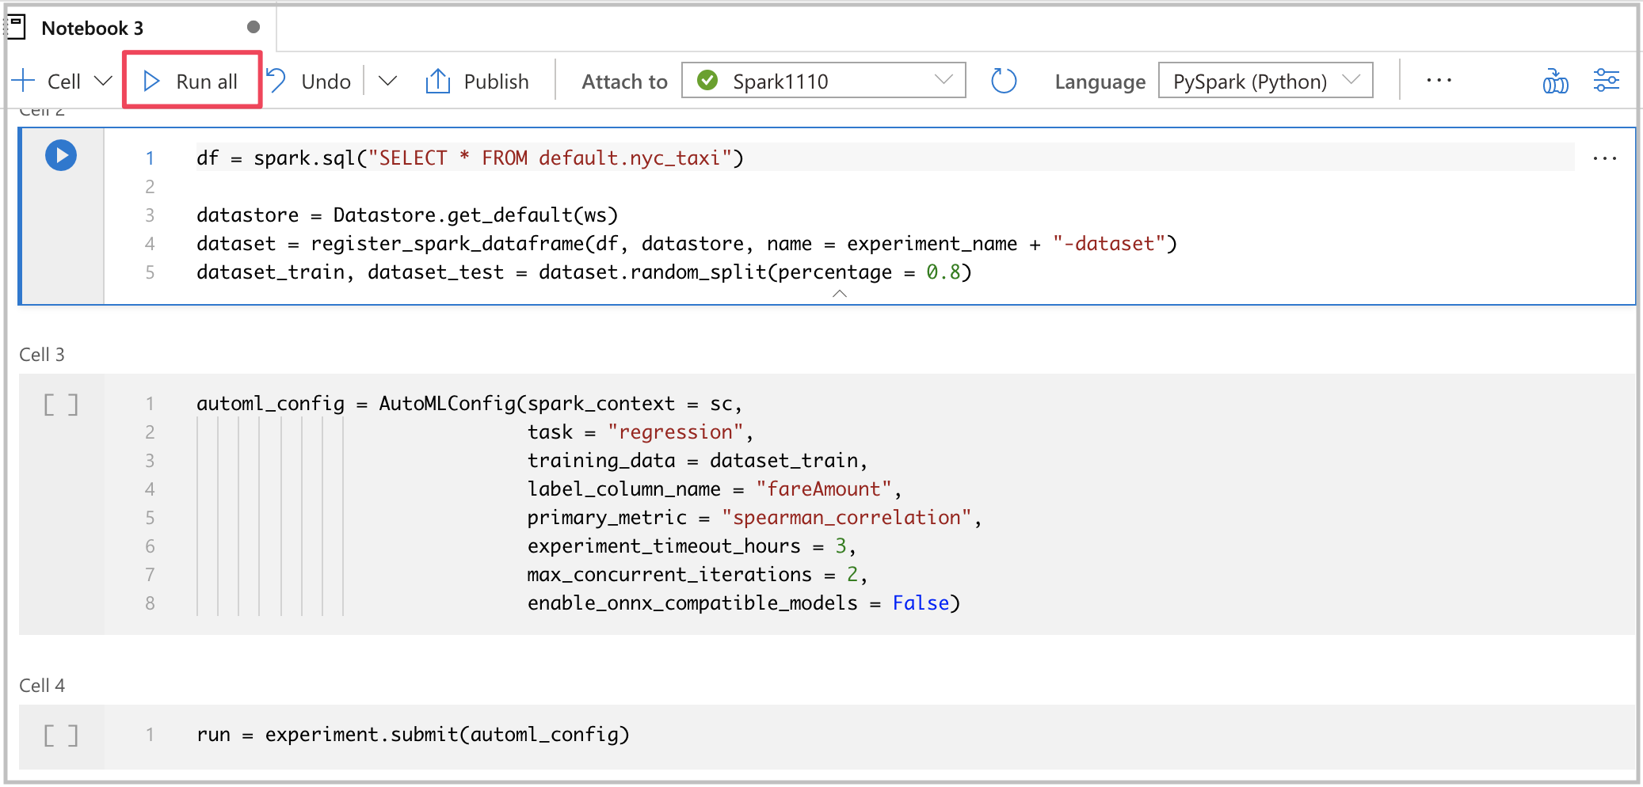
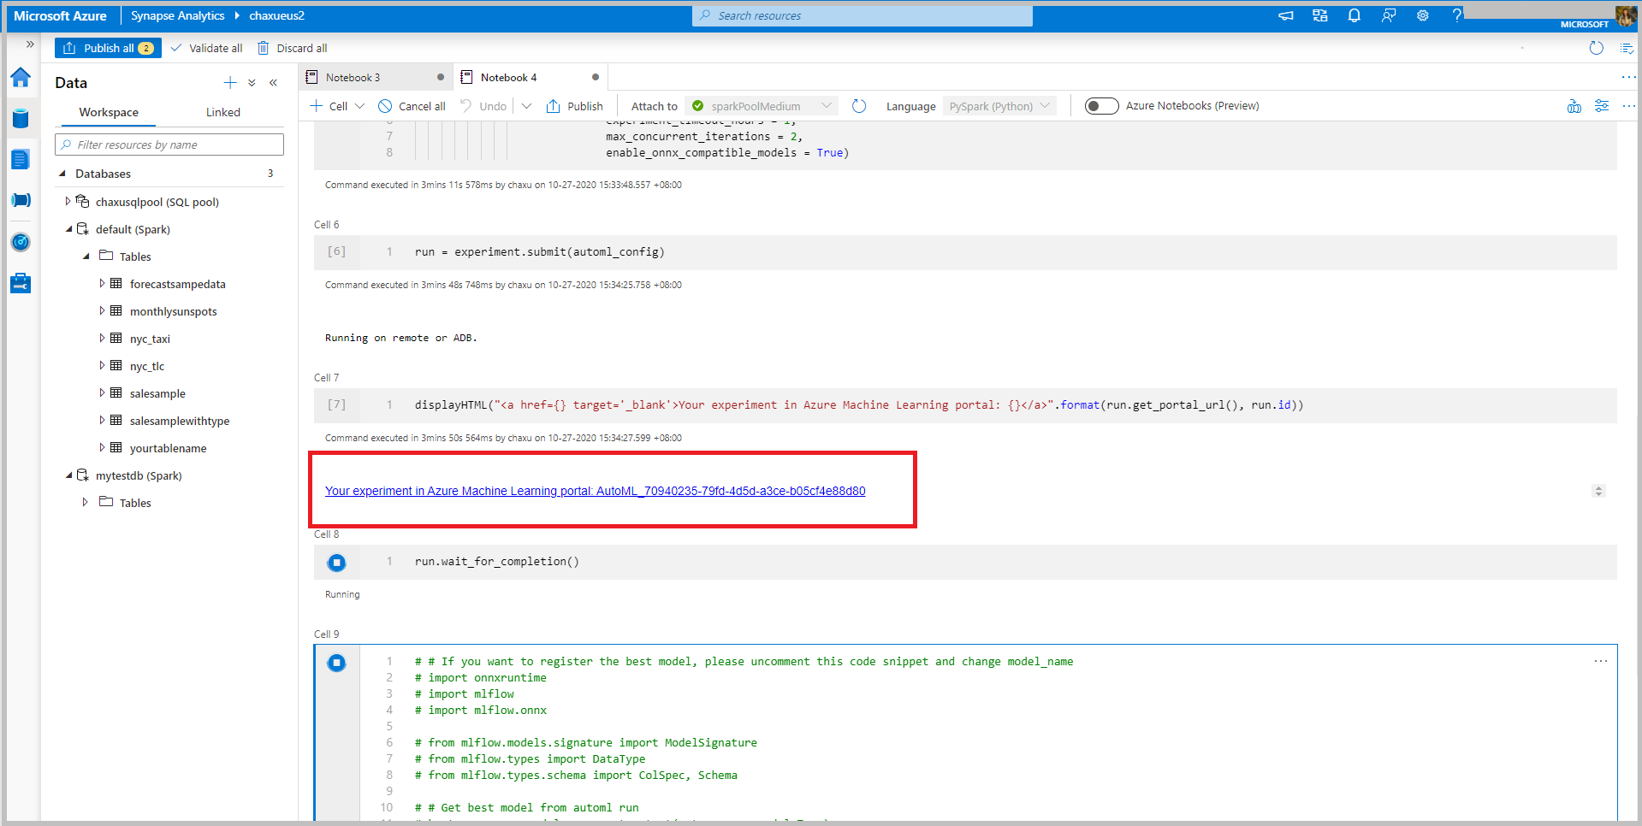
Modeling with Azure Machine Learning – With Code
Notes:
If you were to select “Open in notebook”, PySpark code is generated to create, configure, and submit the experiment to Azure Machine Learning.
Within the generated code, you also have the option of registering the trained model with MLFlow within the Azure Machine Learning workspace.

Slide 32
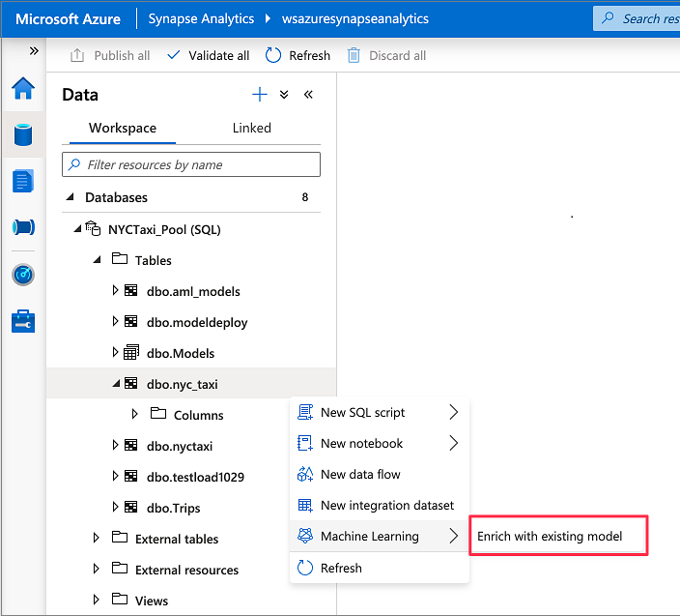
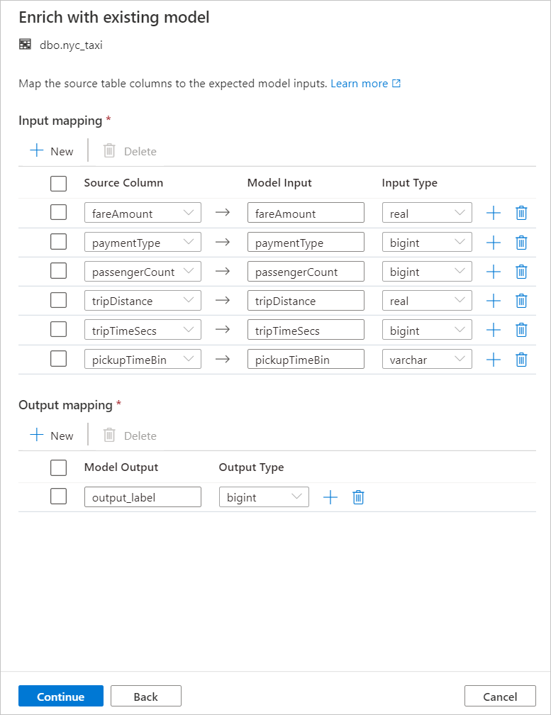
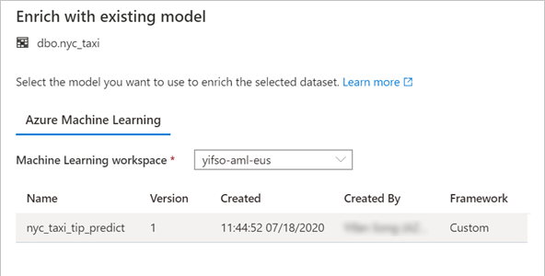
Model deployment and scoring – Code Free
Notes:
Models can be deployed several ways. One way is to create a service by deploying to ACI or Kubernetes. This can be automated through a Spark Notebook or by leveraging the deployment features of the Azure Machine Learning resource user interface. Within Synapse, you could train an ONNX model and store it directly in the SQL pool for use with the TSQL Predict function.
1) A SQL scoring wizard is available in Synapse Studio by right clicking a table, and selecting “Enrich with Existing Model”.
2) This action will let you select models registered in a linked azure machine learning workspace.
3) Based on the columns of the data table, you are able to map the input columns to the input of the model.

Slide 33
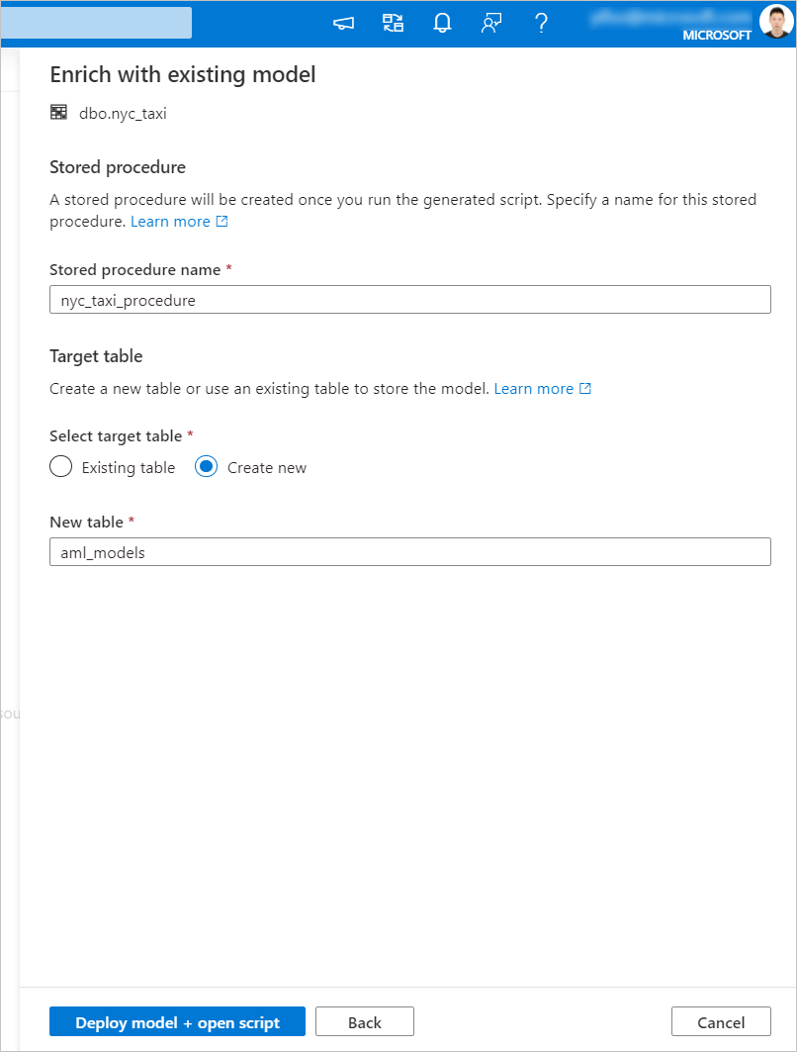
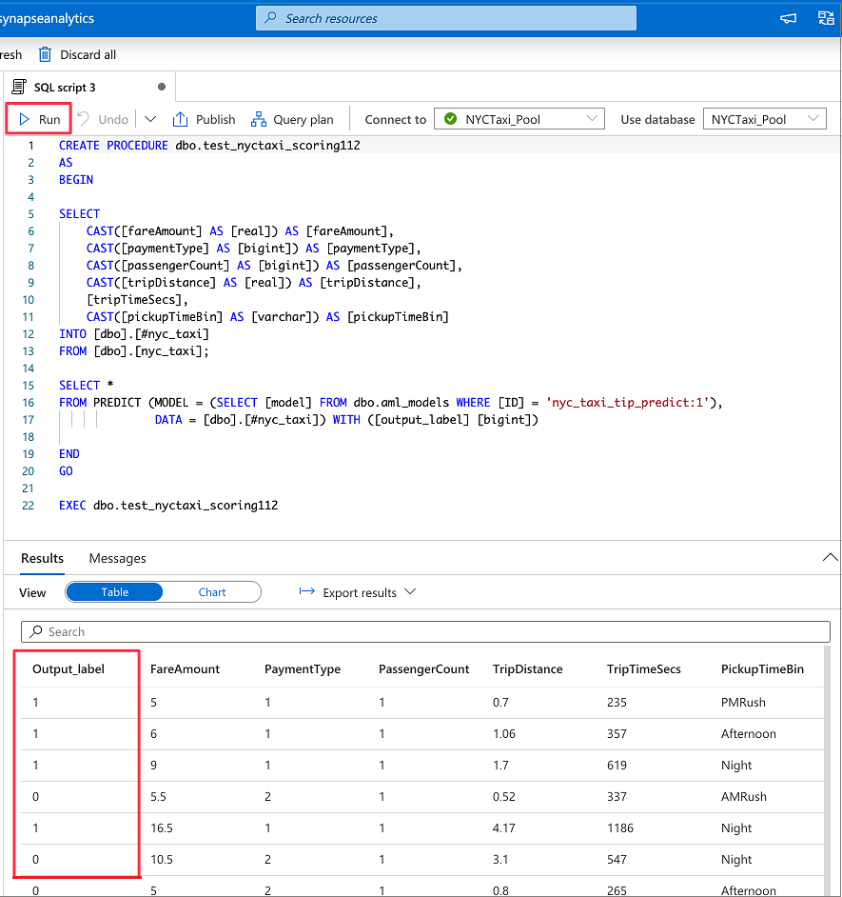

Model deployment and scoring – Code Free (cont…)
Notes:
4) The scoring wizard generates a stored procedure to exercise the model, and will also store the model physically in the database in the table of your choice, whether it be an existing table or a completely new one.
5) The stored procedure script is then displayed and you could run the model based on the dataset specified in the previous steps.
Another option, of course, is to leverage the code experience in Apache Spark Pools for Azure Synapse for your batch scoring and use SDKs to deploy to ACI, Kubernetes, or the destination of your choice.

Slide 34
Predict
Overview
It provides ability to import existing machine learning models and score them within provisioned SQL. It takes ONNX (Open Neural Network Exchange) and data as inputs and generates prediction based on model.
Benefits
It empowers data engineers to successfully deploy machine learning models with the familiar T-SQL interface
It offers seamless collaboration with data scientists
It generates new columns, but the number of columns and their data types depends on the type of model that was used for prediction.
Syntax:
PREDICT
(
MODEL = @model | model_literal,
DATA = object AS <table_alias>
)
WITH ( <result_set_definition> )
<result_set_definition> ::=
{
{ column_name
data_type
}
[,...n ]
}
MODEL = @model | model_literal
Example:
DECLARE @model varbinary(max) = (SELECT Model FROM Models WHERE Id = <>);
SELECT d.*, p.Score
FROM PREDICT(MODEL = @model,
DATA = dbo.mytable AS d) WITH (Score float) AS p;

Slide 35
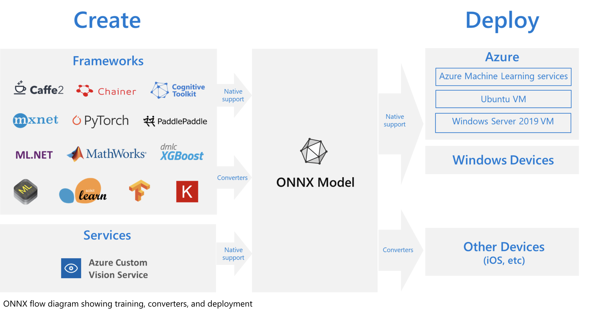
What is ONNX?
Notes:
The challenges of optimizing the performance of machine learning models in production is extremely hard considering the range of hardware capabilities on different platforms such as cloud vs edge, CPU vs GPU etc. and couple that with the variety of frameworks that available for building and training the machine learning models.
To support the idea of providing users the flexibility to train their machine learning models on framework of their choice, and run that model anywhere with optimal performance, is at the core of Open Neural Network Exchange (ONNX) format for representing machine learning models. ONNX is an open format, that is supported by a community of partners, including Microsoft, who create compatible frameworks and tools.
You can create ONNX models from many frameworks, including PyTorch, Chainer, Microsoft Cognitive Toolkit (CNTK), MXNet, ML.Net, TensorFlow, Keras, SciKit-Learn, and more. ONNX Runtime is optimized for both cloud and edge and works on Linux, Windows, and Mac, and it also integrates with accelerators on different hardware such as TensorRT on NVidia GPUs. ONNX models can be deployed to the cloud using Azure Machine Learning and ONNX Runtime. They can also be deployed to Windows 10 devices using Windows ML. They can even be deployed to other platforms using converters that are available from the ONNX community.
The interoperability you get with ONNX makes it possible to get great ideas into production faster. With ONNX, data scientists can choose their preferred framework for the job. Similarly, developers can spend less time getting models ready for production, and deploy across the cloud and edge.
Data scientists: use the framework of their choice to create and train models
Developers: deploy models cross-platform with minimal integration work

Slide 36
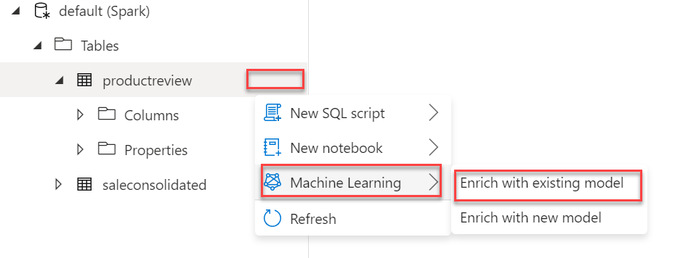
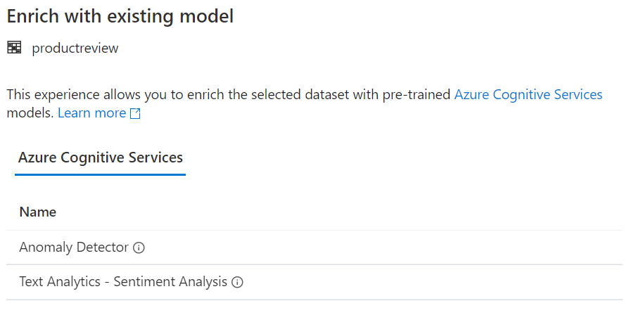
Leveraging Cognitive services
Enrich with existing model
Select from the Cognitive Services available
Choose the appropriate Cognitive Service resource
Cog. Svc. API Key must be stored in a Key Vault
Set input column
Generates a PySpark Notebook that applies the cognitive service model to the column chosen
Notes:
Enrich with existing model allows you to select the type of Cognitive Services you wish to consume.
You will be given the choice of Cognitive Services accounts that are available in your subscription
The Cognitive Services Key must be stored in an Azure Key Vault secret
The wizard will output a Spark Notebook that executes the chosen Cognitive Service against the columnar data chosen from the Spark table.

Slide 37
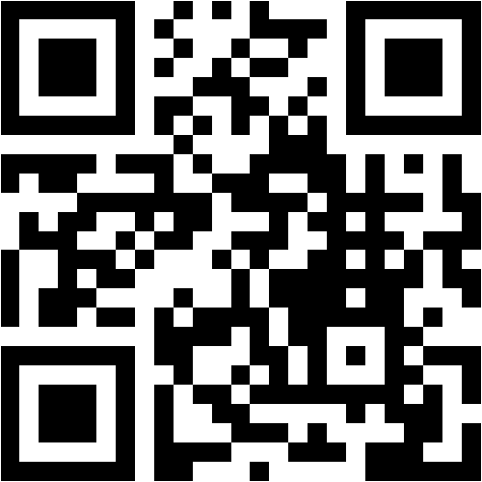
Mentimeter Poll
Scan QR Code
or Go to www.menti.com and use code
9728 4952
Notes:
Questions:
Did you attend the Azure Synapse Analytics Bootcamp training last year (yes/no)
What is your job role – CSA, GBB, ….
Have you been hands-on with Azure Synapse Analytics? (yes/no/a little)
How confident are you in your Azure Synapse Analytics technical level ? (rating 1-5, 1 being not confident, 5 being very confident)
What do you hope to learn in this session? (word cloud)

Slide 38
Lab environment overview

Slide 39
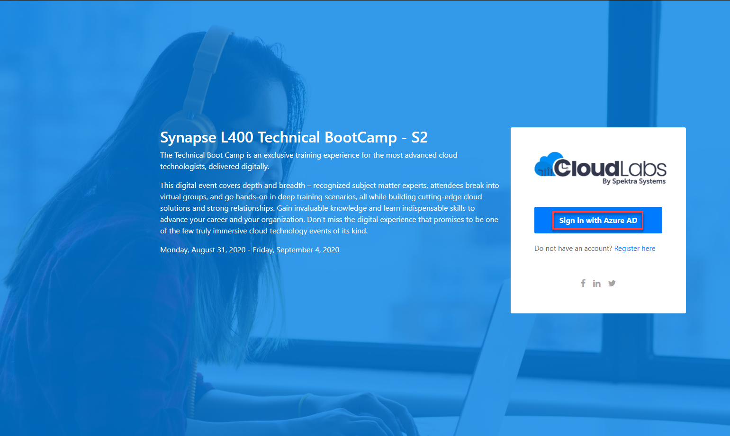
Login to the portal

Slide 40
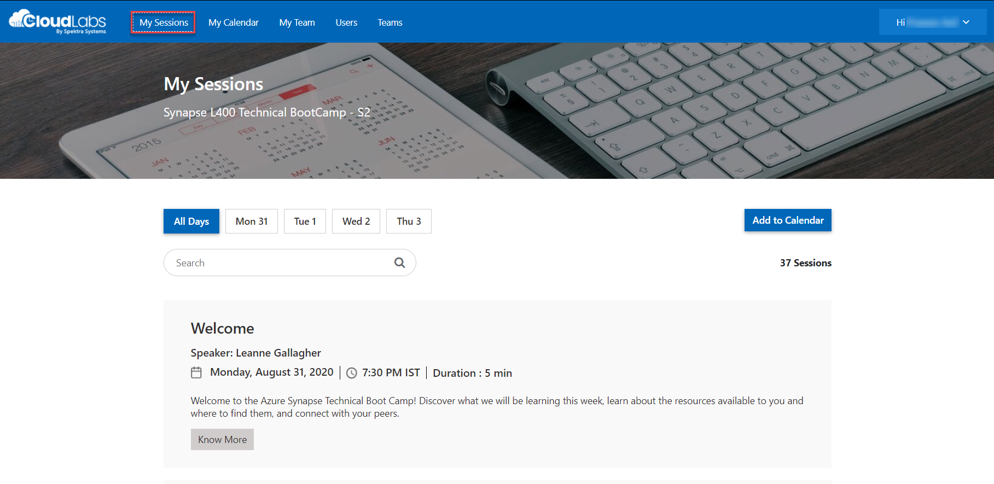
Sessions for Bootcamp

Slide 41
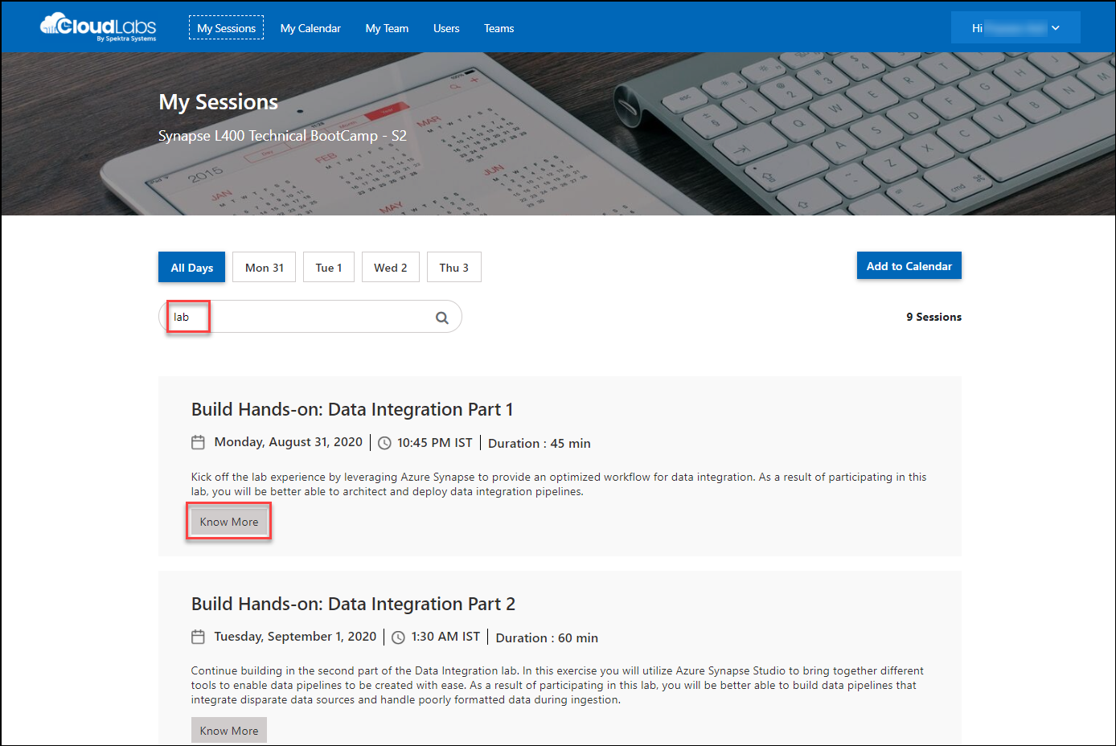
Search for lab
Search for lab
Click on Know More

Slide 42
Thank You slide
Break Time

Slide 43

Lab 01: Azure Machine Learning integration
Objective: As a result of participating in this lab, you will be better able to use the Azure Machine Learning integration is Synapse Studio
What you will be doing: You will work individually in your lab environment to complete a set of tasks to create a machine learning model from within Synapse Studio
Total Activity Time: 60 minutes

Slide 44
Azure Data Explorer integration

Slide 45



What is Azure Data Explorer (ADX)?
Fully managed cluster-based analytics service
Optimized for telemetry and streaming data
KQL query language
Data service powering Azure Monitor, Time Series Insights, and Windows Defender Advanced Threat Protection
Notes:
Azure Data Explorer is a fully managed, cluster-based data analytics service for real-time analysis on large volumes of structured and unstructured streaming data sources. The Azure Data Explorer offers highly scalable infrastructure and performing query performance, having the ability to do complex ad hoc queries on the data in seconds.
Similar to RDBMS in that it has databases, tables, functions and columns. Ability to query including calculated columns, filtering, group-by aggregates and joins. Tables have a schema, but unlike an RDBMS, there is no such thing as keys (like unique keys, primary keys and foreign keys). Relationships are established at query time.
Uses an optimized sql-like language called KQL (Kusto Query Language) – KQL can only read data, never update or delete it
Capability of ingesting 200MB per second per node
Native connectors to Azure Event Grid or Azure Event Hub, also has an SDK
Visualizations capable through tools like PowerBI and Grafana.
Azure Data Explorer is the data service powering products like Azure Monitor, Azure Time Series Insights, and Windows Defender Advanced Threat Protection.

Slide 46
How did ADX come to be?
2014
2016
2018
2019
2014 – R&D
2016 – Added as the data service for Application Insights
2018 – Public preview
2019 - GA
Notes:
Azure Data Explorer really is the new kid on the block, albeit a very powerful one.
Kusto, now known as Azure Data Explorer was created for a distributed fast and scalable log and telemetry analytics engine by Microsoft R&D in 2014.
In 2016, Kusto became the back-end for the existing Application Insights Analytics.
Public preview as an Azure offering began in 2018, and it went GA in 2019.

Slide 47


Azure Data Explorer and Azure Synapse Analytics
Notes:
Create a linked service connection to Azure Data Explorer, this will allow the use of this connection for things like datasets and copy activities.
Behind the scenes, the notebook uses the Azure Data Explorer Connector for Apache Spark, this allows for KQL queries to execute via the linked service to run on the highly efficient Azure Data Explorer infrastructure.
Limitation: Currently not supported with Azure Synapse deployed with a managed VNet

Slide 48

Mentimeter Poll
Scan QR Code
or Go to www.menti.com and use code
7594 9409
Notes:
Questions:
Did you attend the Azure Synapse Analytics Bootcamp training last year (yes/no)
What is your job role – CSA, GBB, ….
Have you been hands-on with Azure Synapse Analytics? (yes/no/a little)
How confident are you in your Azure Synapse Analytics technical level ? (rating 1-5, 1 being not confident, 5 being very confident)
What do you hope to learn in this session? (word cloud)

Slide 49
Spark Updates

Slide 50


UI Changes
Session configuration has been re-located to the top of the notebook.
Package management moved to the “Packages” section of the action menu on a Spark pool in the manage hub.
The Notebook experience now defaults to the preview version.
Notes:
Movement of the session configuration of a notebook
New Library management experience
Preview of new notebook experiences is now default

Slide 51



Configuration updates
New node sizes introduced XLarge and XXLarge
YAML (*.yml) format supported for libraries in addition to requirements.txt
Workspace packages (custom/private wheel (whl)files or jar files) can be uploaded from the Manage Hub
Specific workspace packages can then be selected for use on a Spark Pool via the Package management view
Enabling Session level packages on a Spark pool allows for testing new versions of packages without impacting the underlying pool configuration
Spark Configuration file upload is now available
Notes:
Larger compute sizes available Xlarge (32 vCores/256 GB) and XXLarge (64 vCores/432 GB
YML format supported as long as the packages listed can be downloaded from the default Conda channels, Conga-Forge and PyPi. (preview)
Session-scoped packages via environment.yml
Support for Spark Configuration
Support for Spark Wheel files (workspace packages)

Slide 52

Microsoft Spark Utilities
Overview
It provides utilities for working with file systems, including ADLS Gen2 and Azure Blob Storage.
Benefits
It supports multiple methods for file systems such as List, Copy, Move, Write, Append, Delete file or directory, View file properties, Create new directory, Preview file content.
It supports environment utilities to get username, user id, job id, workspace name, pool name, cluster id.
It supports to get the access tokens of linked services and manage secrets in Azure Key Vault.
Notes:
Microsoft Spark Utilities https://docs.microsoft.com/en-us/azure/synapse-analytics/spark/microsoft-spark-utilities?pivots=programming-language-python
Similar to the Databricks Utilities package, dbutils

Slide 53

Spark Hyperspace
Overview
Hyperspace introduces the ability for Apache Spark users to create indexes on their data
Benefits
It helps accelerate your workloads or queries containing filters on predicates with high selectivity or a join that requires heavy shuffles.
Maintain the indexes through a multi-user concurrency model.
Leverage these indexes automatically, within your Spark workloads, without any changes to your application code for query/workload acceleration.
It supports index operations as create index, list index, restore index, delete index, vacuum index
Languages supported: Scala, Python, .NET
Spark ML Algorithms
Notes:
Hyperspace indexes for Apache Spark - Azure Synapse Analytics | Microsoft Docs https://docs.microsoft.com/en-us/azure/synapse-analytics/spark/apache-spark-performance-hyperspace?pivots=programming-language-python

Slide 54


MMLSpark
Notes:
MMLSpark libraries (preview) [https://docs.microsoft.com/en-us/azure/synapse-analytics/machine-learning/tutorial-build-applications-use-mmlspark] https://github.com/Azure/mmlspark
We mentioned MMLSpark earlier in the class. This framework adds many deep learning and data science tools to the Spark ecosystem including integration with Spark Machine Learning Pipelines with Microsoft Cognitive Toolkit, LightGBM and OpenCV. It also brings networking capabilities with HTTP on Spark that allows embedding any web service into their SparkML models (thus allowing integration with a wide variety of Microsoft Cognitive Services)

Slide 55
Lab 02: Spark
Objective: As a result of participating in this lab, you will be better able to understand Spark Hyperspace and mssparkutil
What you will be doing: You will work individually in your lab environment to complete a set of tasks to index files in storage for faster read performance.
Total Activity Time: 60 minutes

Slide 56
Thank You slide
Break Time

Slide 57
CDM – Common Data Model

Slide 58

What is the Common Data Model
Standard schemas defining the most used concepts and activities
Structural Consistency
Semantic Consistency
Unified shape
Extensible standard entities
Notes:
If you've ever had to bring data from multiple systems and applications together, you know what an expensive and time-consuming task that can be. Without being able to share and understand the same data easily, each application or data integration project requires a custom implementation.
Common Data Model simplifies this process by providing a shared data language for business and analytical applications to use. The Common Data Model metadata system makes it possible for data and its meaning to be shared across applications and business processes such as Microsoft PowerApps, Power BI, Dynamics 365, and Azure.
In addition to the metadata system, Common Data Model includes a set of standardized, extensible data schemas that Microsoft and its partners have published. This collection of predefined schemas includes entities, attributes, semantic metadata, and relationships.
Common Data Model simplifies data management and app development by unifying data into a known form and applying structural and semantic consistency across multiple apps and deployments. To summarize the benefits:
Structural and semantic consistency across applications and deployments.
Simplified integration and disambiguation of data that's collected from processes, digital interactions, product telemetry, people interactions, and so on.
A unified shape, where data integrations can combine existing enterprise data with other sources and use that data holistically to develop apps or derive insights.
The ability to extend the schema and Common Data Model standard entities to tailor the model to your organization.

Slide 59

Common data model documents
JSON based with the extension “*.cdm.json”
Model both physical and logical entities
Create a folder logically named to hold schema files
Import other documents using _allImports.cdm.json or the “imports”: [{ “corpusPath”: “/foundations.cdm.json”}] property
Manifest documents *.manifest.cdm.json acts like an entry point to the entities and should be at the root of the folder. Sub-manifests are also supported
Notes:
CDM documents are json based
A portion of a UserAgent.cdm.json schema can be found to the right of the slide.

Slide 60

Spark CDM connector
Overview
It offers Spark dataframes to read and write entities in a CDM folder.
Benefits
It supports use of Managed Identities for Azure resources to mediate access to the Azure datalake storage.
Writes from a Spark dataframe to an entity in a CDM folder based on dataframe schema or CDM entity definition.
Supports data in Apache Parquet format and CSV format.
The CDM connector is pre-installed and supports languages: Python, Scala
Spark ML Algorithms
Notes:
Azure/spark-cdm-connector (github.com) https://github.com/Azure/spark-cdm-connector

Slide 61


CDM in Data Flows
Available in Data flows as an Inline source type
Source/Sink options allows for the selection of the manifest and root location and Entity

Slide 62
Azure Purview integration

Slide 63

What is Azure Purview
Overview
SaaS unified data governance tool for on-premises and cloud data. Provides a holistic and up to date view of your data landscape.
Benefits
Purview Data Map is automatically kept up to date with built-in automated scanning and classification system
Rich User Interface – Azure Purview Data Map. Users can quickly and easily find relevant data based on filters.
Centrally located data documentation. Users can contribute to the catalog to enrich automatically obtained metadata.
Notes:
Azure Purview is a unified data governance service that helps you manage and govern your on-premises, multi-cloud, and software-as-a-service (SaaS) data. Easily create a holistic, up-to-date map of your data landscape with automated data discovery, sensitive data classification, and end-to-end data lineage.
Users contribute by tagging, documenting, and annotating data sources that have already been registered. They can also register new data sources, which are then discovered, understood, and consumed by the community of catalog users

Slide 64



Connecting Purview with Azure Synapse
Manage hub -> External connections -> Azure Purview (Preview)
Provides a Purview search bar at the top of Synapse Studio in the Data, Develop, and Integrate Hubs.
For the search to work, data sources must be registered in Azure Purview (ex. ADLS Gen 2, Azure Data Explorer, Dedicated SQL Pool)
Notes:
Ensure the MSI of Azure Purview has access to resources you want scanned

Slide 65
Demo
Azure Purview integration with Synapse
Notes:
Pre-requisite
Create a Purview account
Make sure the Purview MSI has Storage Blob Reader to the ADLS Gen 2 storage account
Create a connection to the ADLS Gen 2 (Azure Data Lake Storage 2), that has the CDM folder
Pre-run the scan of the data lake account
Walkthrough connecting Purview in Synapse
In Synapse Studio, go to Manage -> Azure Purview (Preview)
Connect to the Purview account
Open the Purview account
Show the ADLS Gen 2 connection
Show the CDM assets registered
Search for one of the CDM assets in Purview – “CustomerId”
Select “SaleSmall” -> select “Schema” show CustomerId field
Open Synapse Studio, data hub, make same search – “CustomerId”
Select “SaleSmall” -> select “Schema” show CustomerId column
Select the CustomerId column, select Related and show graph, select nodes for the popup

Slide 66
Lab 03: CDM
Objective: As a result of participating in this lab, you will be better able to understand how to use and leverage CDM in a solution.
What you will be doing: You will work individually in your lab environment to complete a set of tasks to leverage CDM in a solution.
Total Activity Time: 60 minutes

Slide 67
Thank You slide
Break Time

Slide 68
Monitoring enhancements
Notes:
Activity Log -> Diagnostic Settings
Data discovery and classification
Metrics / Metrics dashboard https://techcommunity.microsoft.com/t5/azure-synapse-analytics/azure-metrics-dashboard-for-azure-synapse-analytics-part-1/ba-p/2016393

Slide 69

Monitoring enhancements
Synapse Studio Monitor Hub now displays resource consumption-based data both real-time and historical
Spark application playback
Azure portal Azure monitor improvements
More alert conditions
Azure portal Data classification and discovery UI
Azure portal Dynamic data masking UI
Notes:
We will demonstrate some of these new features now

Slide 70
Demo
Monitoring enhancements
Notes:
Pre-requisite
1 Spark pool that has a history of running notebooks
1 SQL Pool not paused with history
Walkthrough Spark Analytics Pools
In Synapse Studio, access the Monitor Hub
Identify the new Analytics Pools section
Select Apache Spark Pools
Show how the current allocation of the pool is shown (at zero)
Start a notebook with a read task (read a parquet file from storage)
While the notebook session starts, return to the Monitor Hub, select the SparkPool01
This screen is a dashboard, look at a historical data such as vCore allocation, active applications, ended applications
From the top toolbar, select “View applications”, this will show a list of stopped, timed out, and running notebooks. Notice that “canceled” is no longer a status, that has been replaced with a stopped status. ** THIS IS ALSO AVAILABLE FROM THE MONITOR -> SPARK APPLICATIONS***
Select the running application, give it a moment, and logs should start showing up
Go back to the application list, select one that is stopped. Show the playback feature.
Note that on the dashboard it shows 1 active application running, the refresh of the active users, allocated vcores, and allocated memory may take a few minutes to show up
Walkthrough SQL Analytics Pools and SQL requests
In the Monitor Hub, select SQL pools
Show the new columns for CPU utilization and Memory Utilization
Select SQLPool01 and show the historic resource usage
Go to SQL Requests, show how you can now pull up queries from the serverless built-in pool, especially the data processed
Select the “More” link next to request content to see the query executed
Pull up queries for SQLPool01, note how there is now a workload group
Walkthrough portal enhancements
In the Synapse Workspace resource in the Azure Portal
Select “Activity Log”, then “Diagnostic Settings”, select “+ Add Diagnostic setting”
Explain destinations and categories, archiving to storage account, read with Spark
Return to the Synapse Workspace, select “Metrics”
Select “Login attempts” metric and “Sum” aggregation as an example
Return to the Synapse Workspace, select “Alerts”
Select “Add condition”, which shows a list of the “signal logic”, select “Data processed (bytes)” as an example
Return to Synapse workspace, and select SQLPool01, scroll to the bottom and it shows the Workload group allocation %ages.
Select “Data Discovery and classification”, wait for the recommendations to show up, then show them and how to remediate
Select “Dynamic Data Masking”, show recommendations for added masks. Add a mask to the field, then select it to show how it can be customized.

Slide 71
Migrating existing data warehouses

Slide 72

Notes:
As customers consider modernizing their data warehouse systems, one of the critical blockers they face is translating their SQL code. The existing code is written and optimized for their current system but needs to be optimized for the new system they're migrating to.
Azure Synapse Pathway’s goal is to preserve the functional intent of the original code while optimizing for Synapse SQL. Synapse Pathway uses a three-stage process for translating SQL code from a source system to Azure Synapse SQL.
Synapse Pathway translates Data Definition Language (DDL) and Data Manipulation Language (DML) statements into T-SQL compliant language that is compatible with Azure Synapse SQL.
Azure Synapse Pathway supports code conversion of database, schemas, and tables for the following sources:
IBM Netezza
Microsoft SQL Server
Snowflake
Each of the stages preserves and augments the knowledge of the source including source-specific metadata to ensure the highest quality in translation.

Slide 73

Stage 1 – Lexing and parsing
Processes SQL input into an augmented Abstract Syntax Tree used in further processing
Stage 2 – Augmented abstract syntax tree (AST)
Using the augmented Abstract Syntax Tree, code is translated between systems
ABS(float_expression)
ABS(numeric_expression)
Stage 3 – Syntax generation
DDL and load scripts are created for the target system
Notes:
Stage 1 – Lexing and parsing
SQL Language parsing is a problem that has been solved many times over. There are many commercial and open-source parsers that help with the underlying process of taking a source statement, breaking it down into logical tokens and then executing against a set or parser rules to ensure language consistency.
Synapse Pathway defines source grammars that allow the tool to identify and process the SQL input into an augmented Abstract Syntax Tree (AST) that is used in further processing.
Stage 2 - Augmented abstract syntax tree (AST)
Synapse Pathway defines a common representation of all objects in an augmented Abstract Syntax Tree (AST). The Synapse Pathway AST includes additional statements or fragmented metadata that is used to make the proper decision when translating code between the two systems.
By not just tracking that a token is a function but rather the source system type requirement, the script generation components can make smarter decisions about translating to Synapse SQL.
In this simple case, Synapse Pathway understands that the conversion in Synapse SQL from float to numeric is an implicit conversion and requires no further type casting. Simple, clean, and effective code translation.
Stage 3 - Syntax generation
The last stage of the process is to generate syntax for Synapse SQL. Using the AST structure generated from the source files, Synapse Pathway writes each DDL object to an individual file. The syntax generators use in-depth knowledge of the target platform to optimize statements.

Slide 74

Translation results

Slide 75
Demo
Migrating existing data warehouses
Notes:
i

Slide 76
Migrating from Azure Data Factory

Slide 77

Migration from Azure Data Factory
Synapse Pipelines has the same code-base
Behind the scenes all assets in ADF and Azure Synapse are stored as JSON files
Export ADF artifacts as a Zip file “Download support files”
Import ADF artifacts into Azure Synapse
Automate with PowerShell (Az.Synapse module), or import manually through the UI

Slide 78

Mentimeter Poll
Scan QR Code
or Go to www.menti.com and use code
5333 4597
Notes:
Questions:
Did you attend the Azure Synapse Analytics Bootcamp training last year (yes/no)
What is your job role – CSA, GBB, ….
Have you been hands-on with Azure Synapse Analytics? (yes/no/a little)
How confident are you in your Azure Synapse Analytics technical level ? (rating 1-5, 1 being not confident, 5 being very confident)
What do you hope to learn in this session? (word cloud)

Slide 79
Lab 04: Migrating ADF assets
Objective: As a result of participating in this lab, you will be better able to understand how to migrate Azure Data Factory Assets into Azure Synapse Analytics.
What you will be doing: You will work individually in your lab environment to complete a set of tasks to import Azure Data Factory assets into Azure Synapse Analytics.
Total Activity Time: 60 minutes

Slide 80
Thank You slide
Thank you

